Slide 1
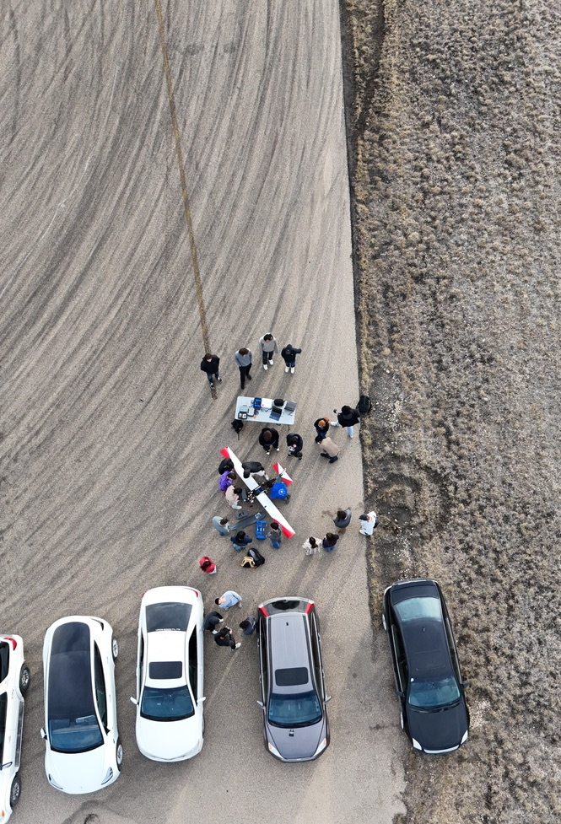
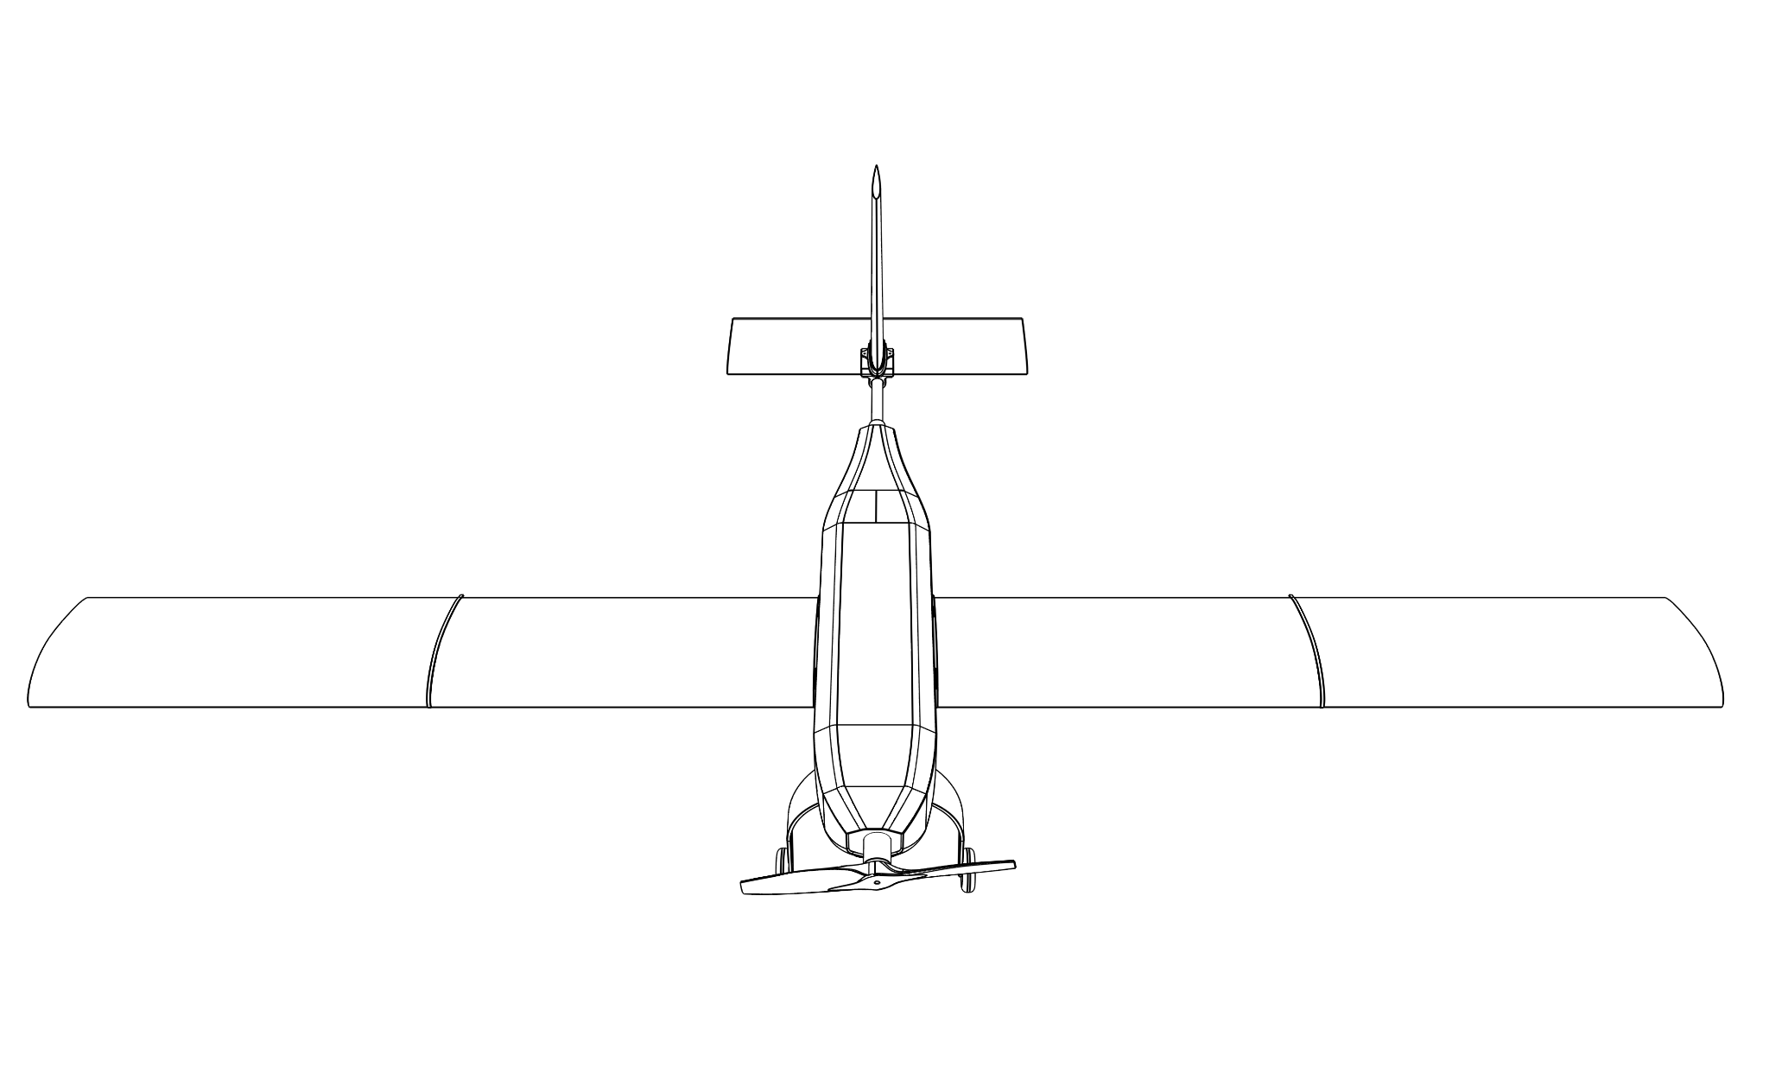
Schulich UAV
Lunch & Learn 2025
Notes:
Liam

Slide 2
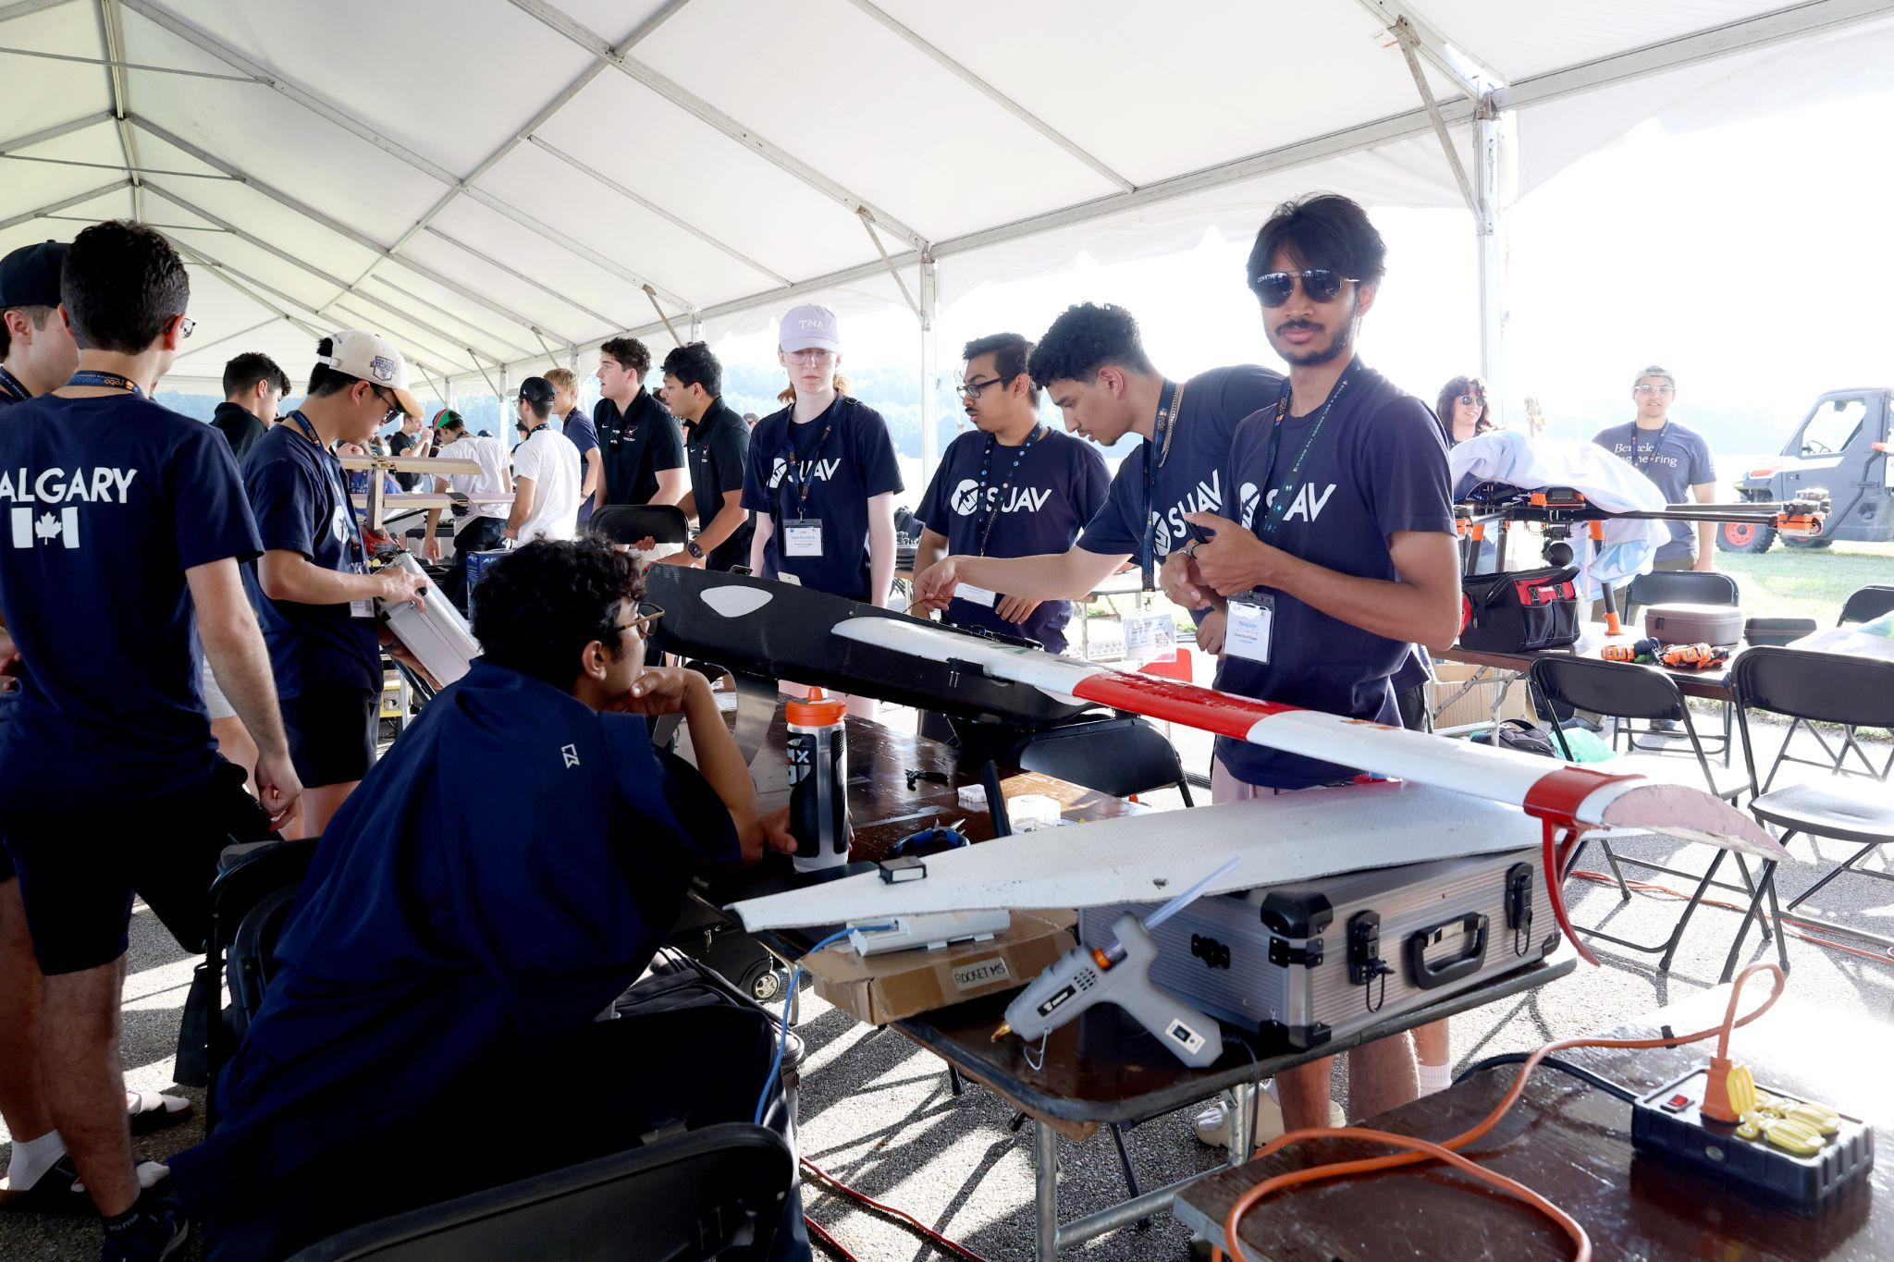
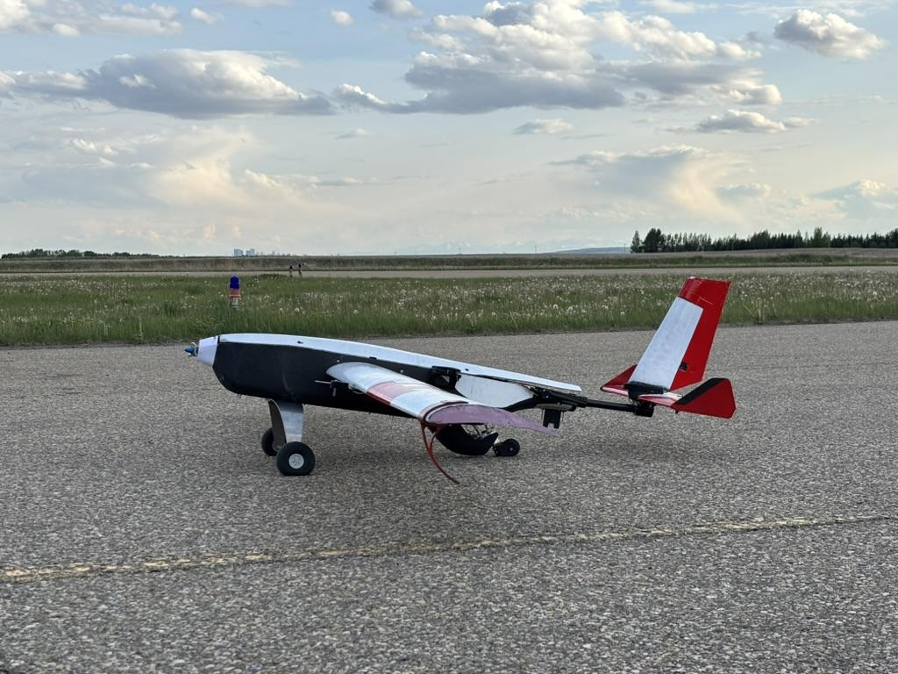
Today’s L&L
Our team
Competition requirements
Aircraft
Custom GCS
Challenges
Competition recap video
Notes:
Liam

Slide 3
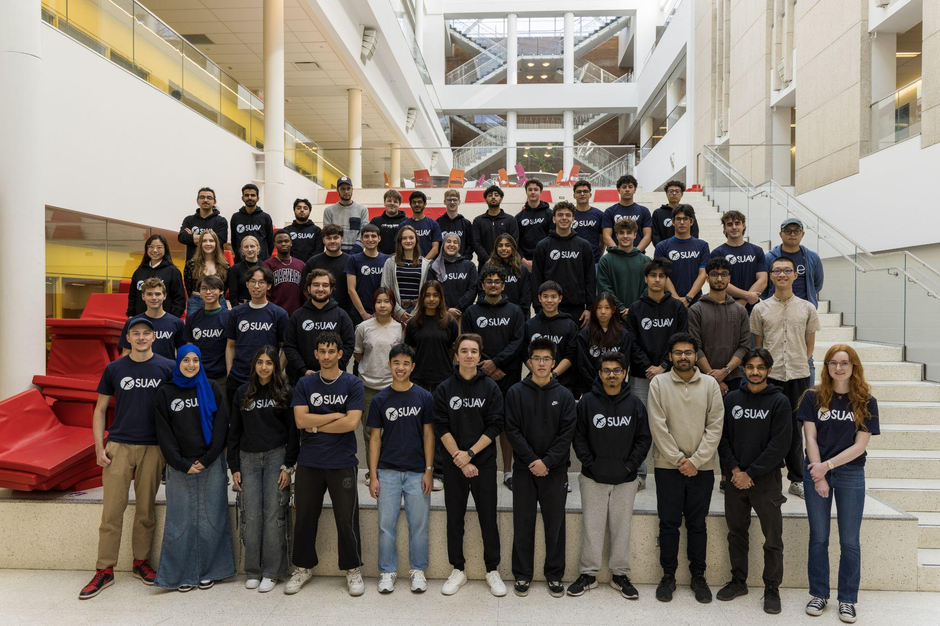
Our Team
Notes:
Liam
60+ students

Slide 4
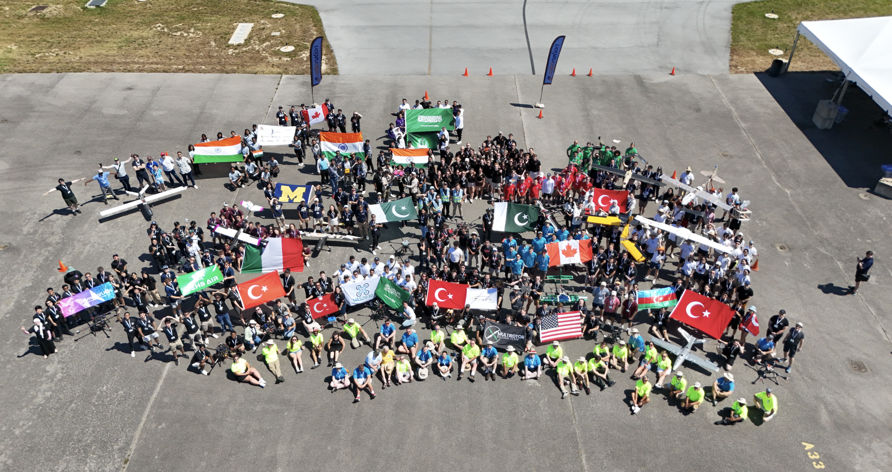
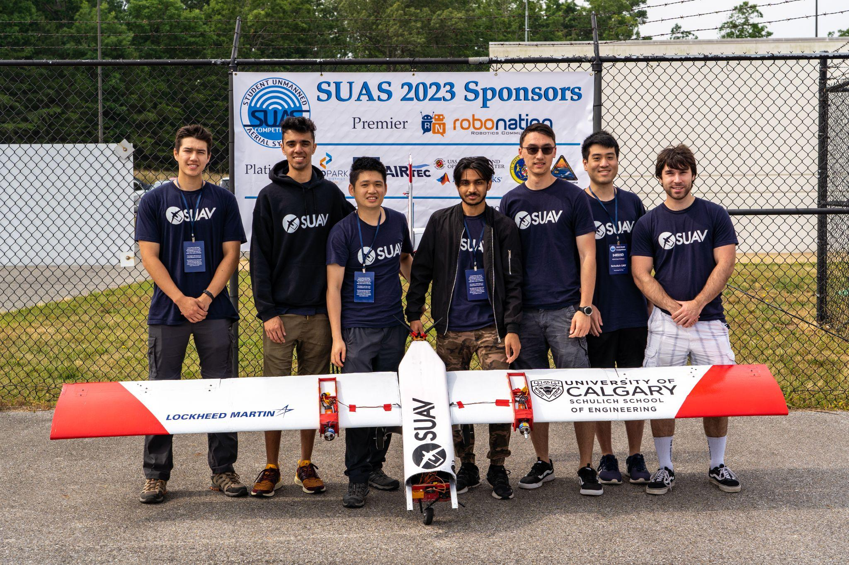
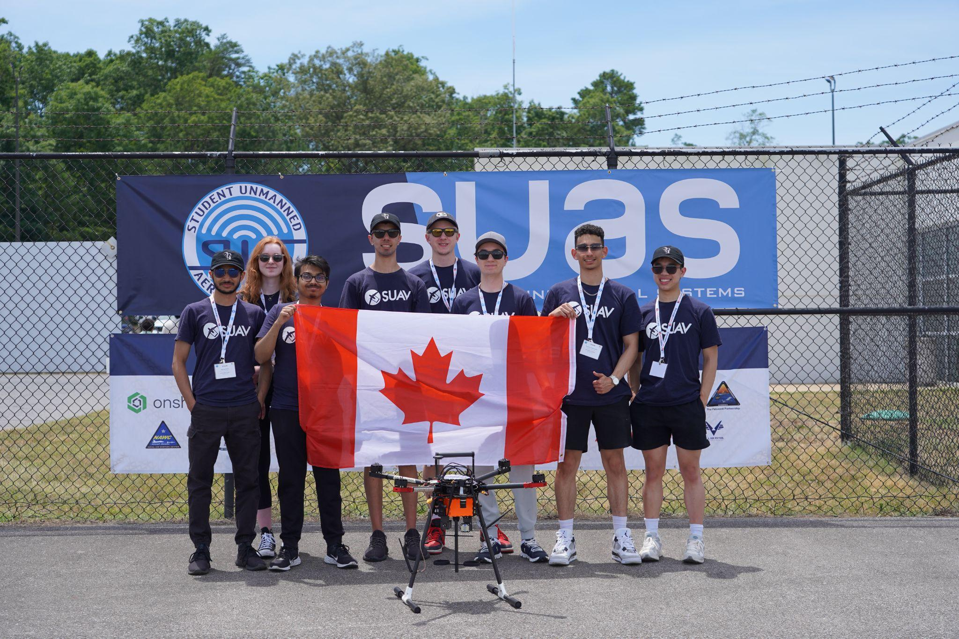
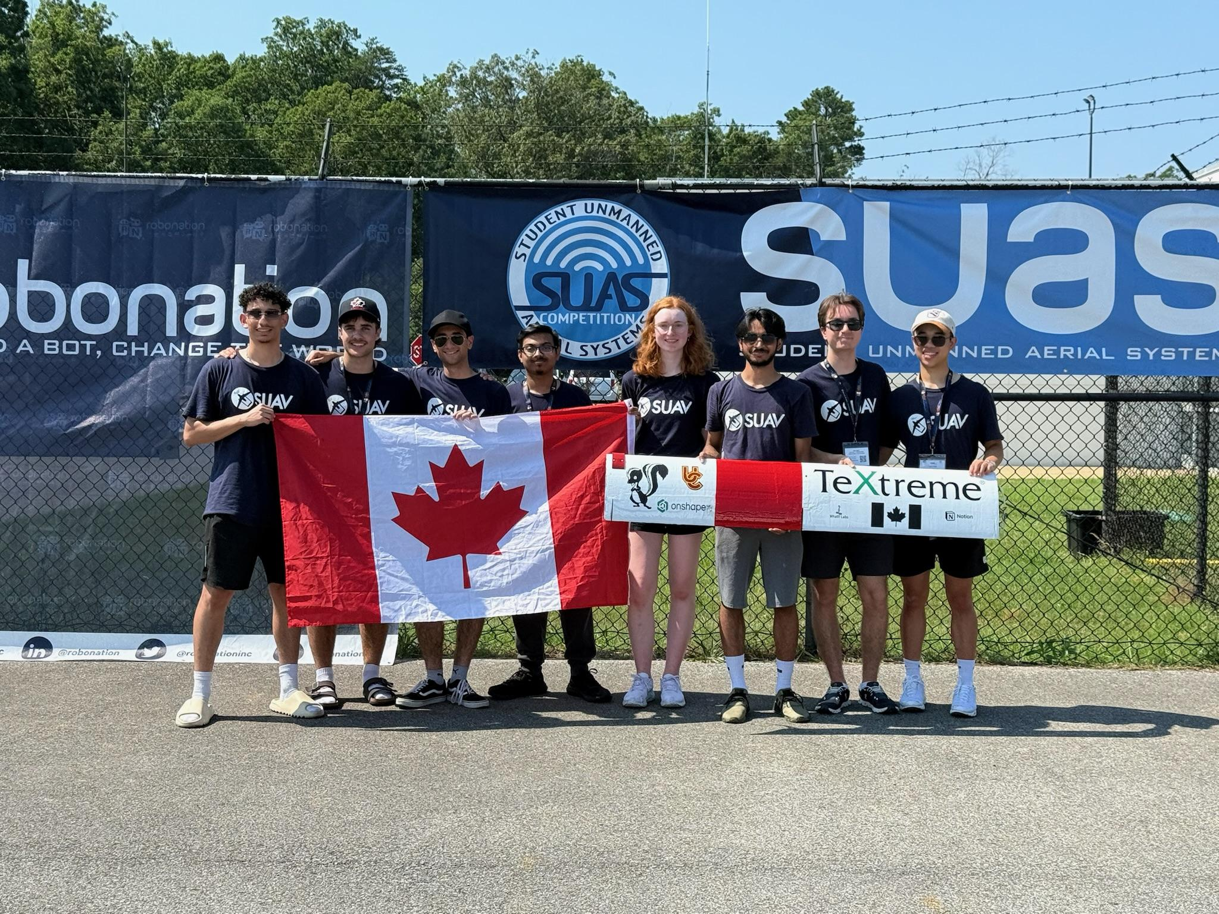

Competition - SUAS 2025
Largest student UAV competition in the world
81 teams from 19 countries
Designed to create interest in UAS to push students towards UAS technologies and careers
Notes:
Haziq

Slide 5
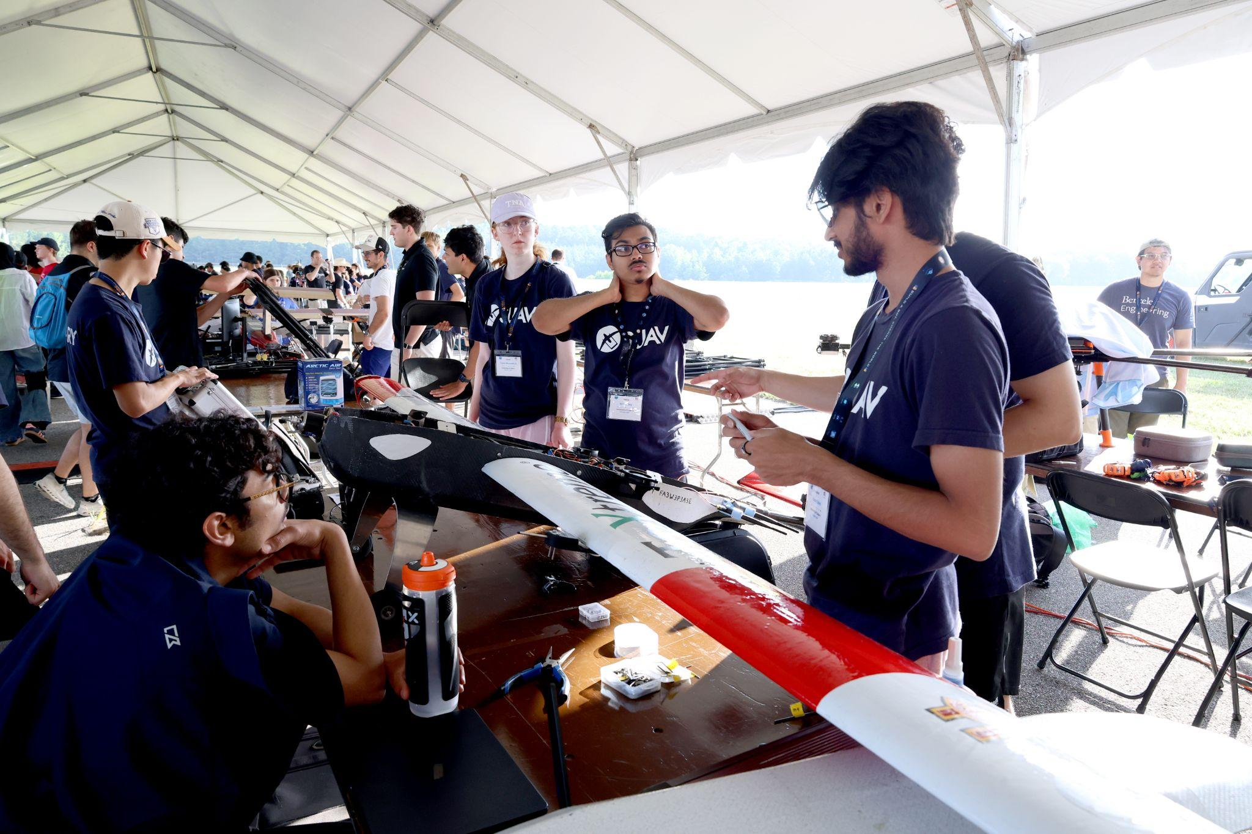
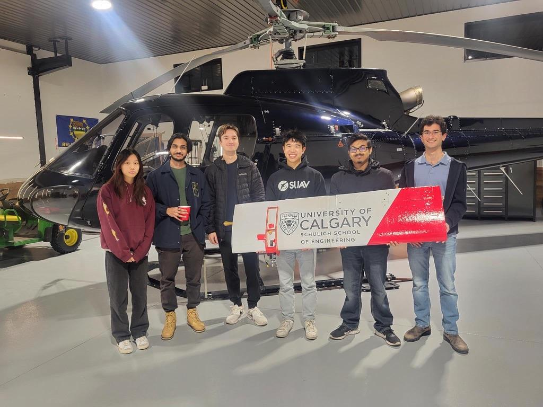
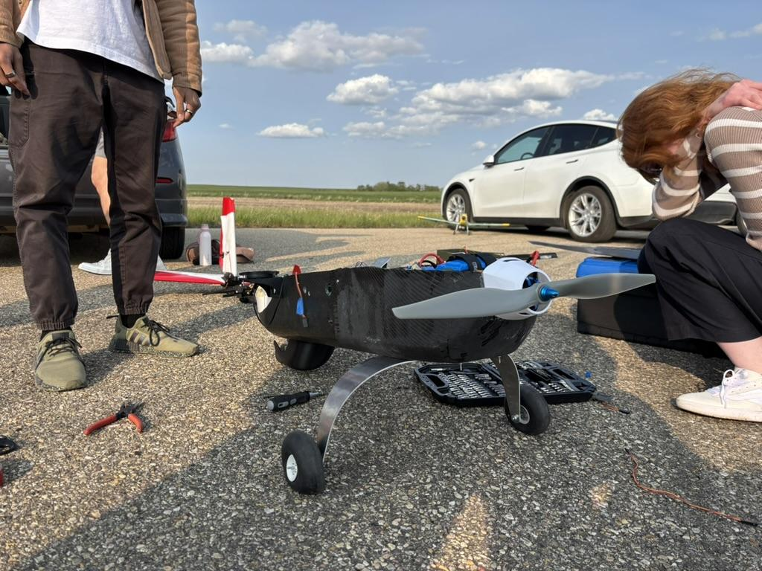
Design Goals & Submissions
Proof of Flight Readiness Video: Proof of flight
Technical Report: Design decisions & competition plan
Team Website: Team, sponsors, media, design, history
Mission: Fly 12 miles autonomously with mapping and payload drops
Notes:
Haziq

Slide 6
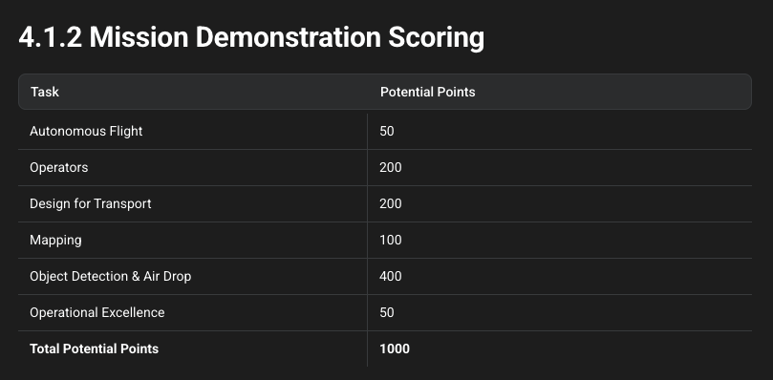
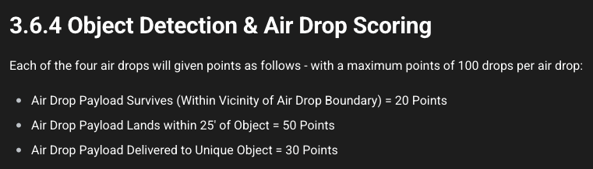
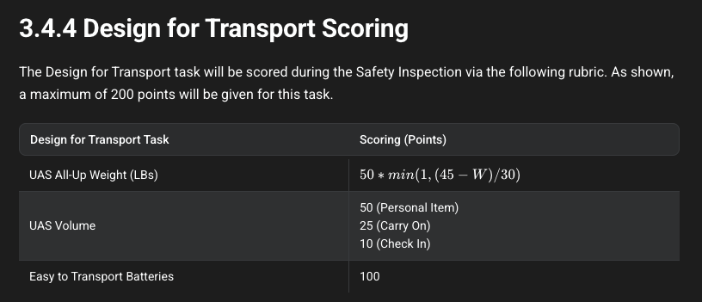
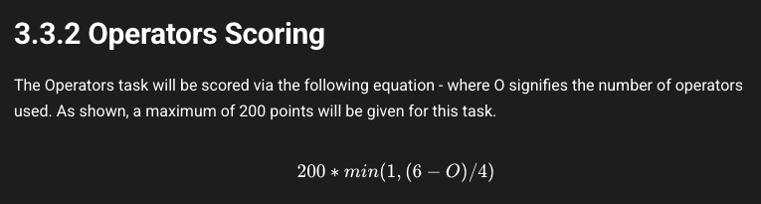
Mission Demonstration
Notes:
Haziq

Slide 7
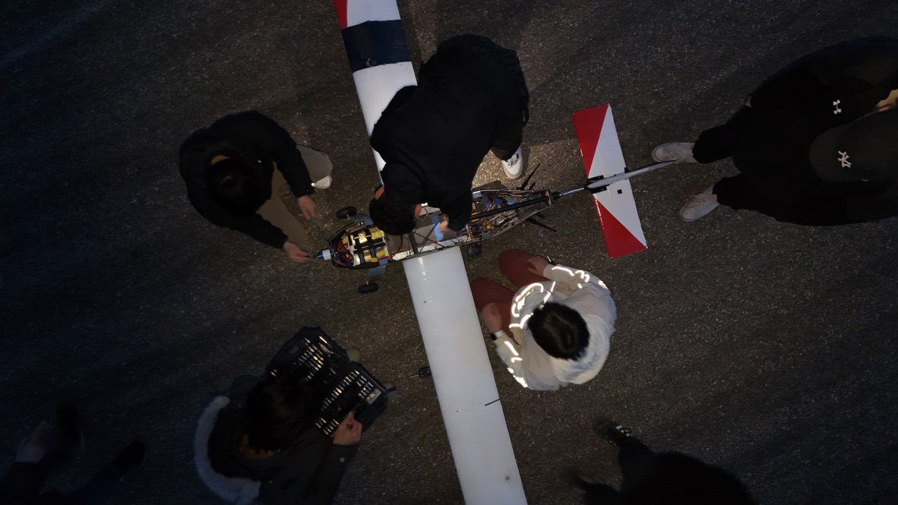
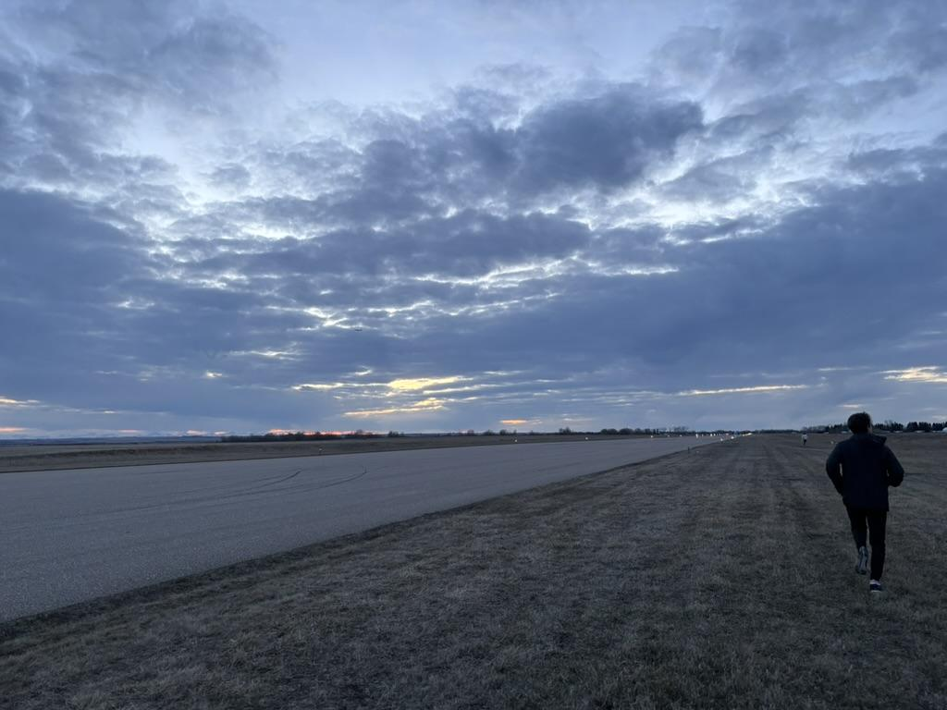
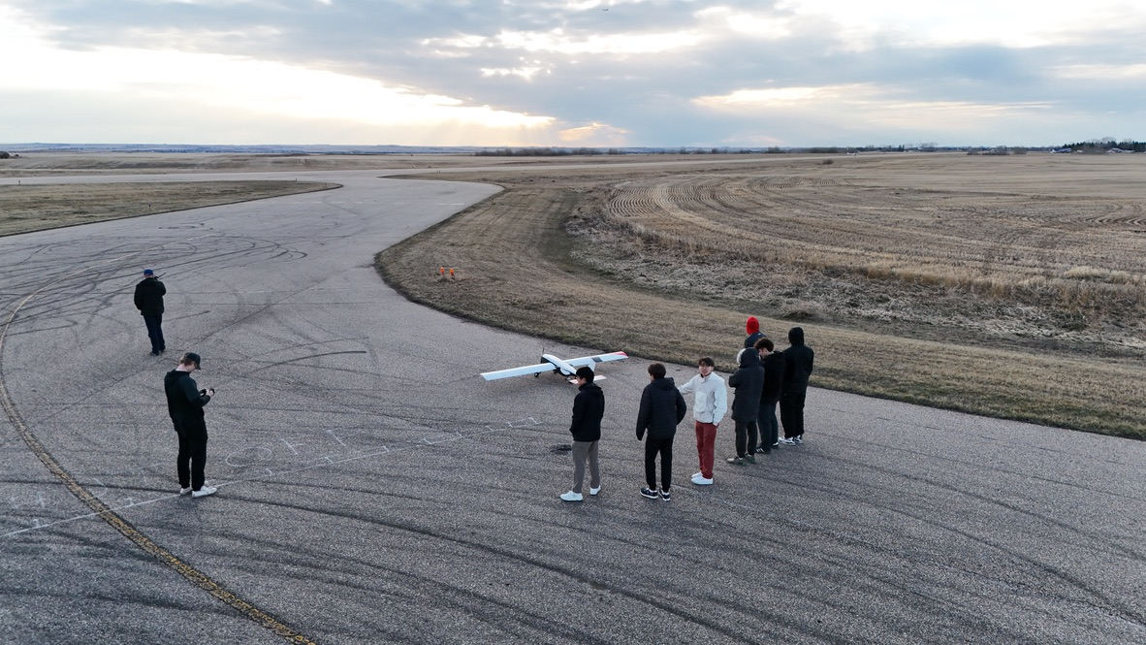
System Requirements
Fully autonomous
Maximum waypoint error of 50ft
Maximum turn radius of 150ft
Angle of climb/descent of 20 degrees
Minimum altitude of 75ft AGL, maximum altitude of 400ft AGL
Able to takeoff and land in runway 70ft x 500ft
Notes:
Haziq

Slide 8
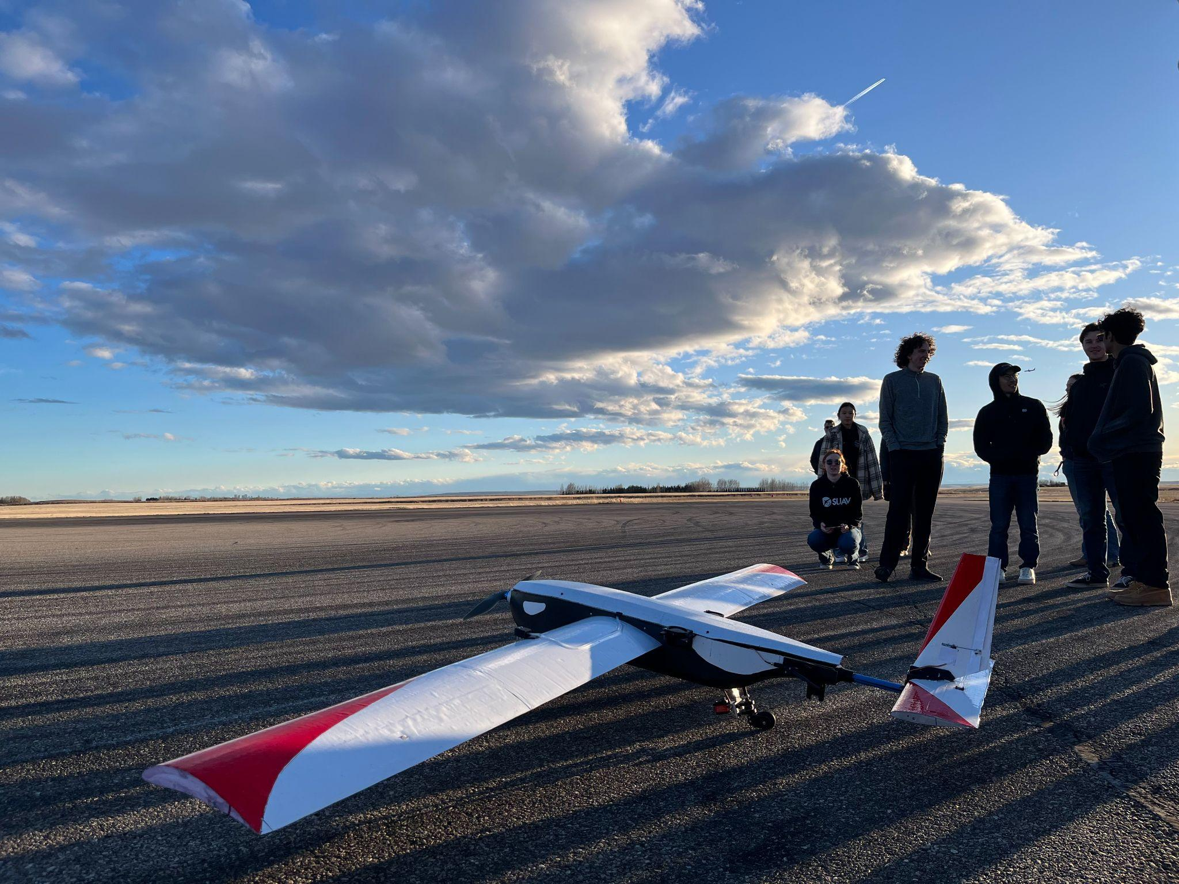
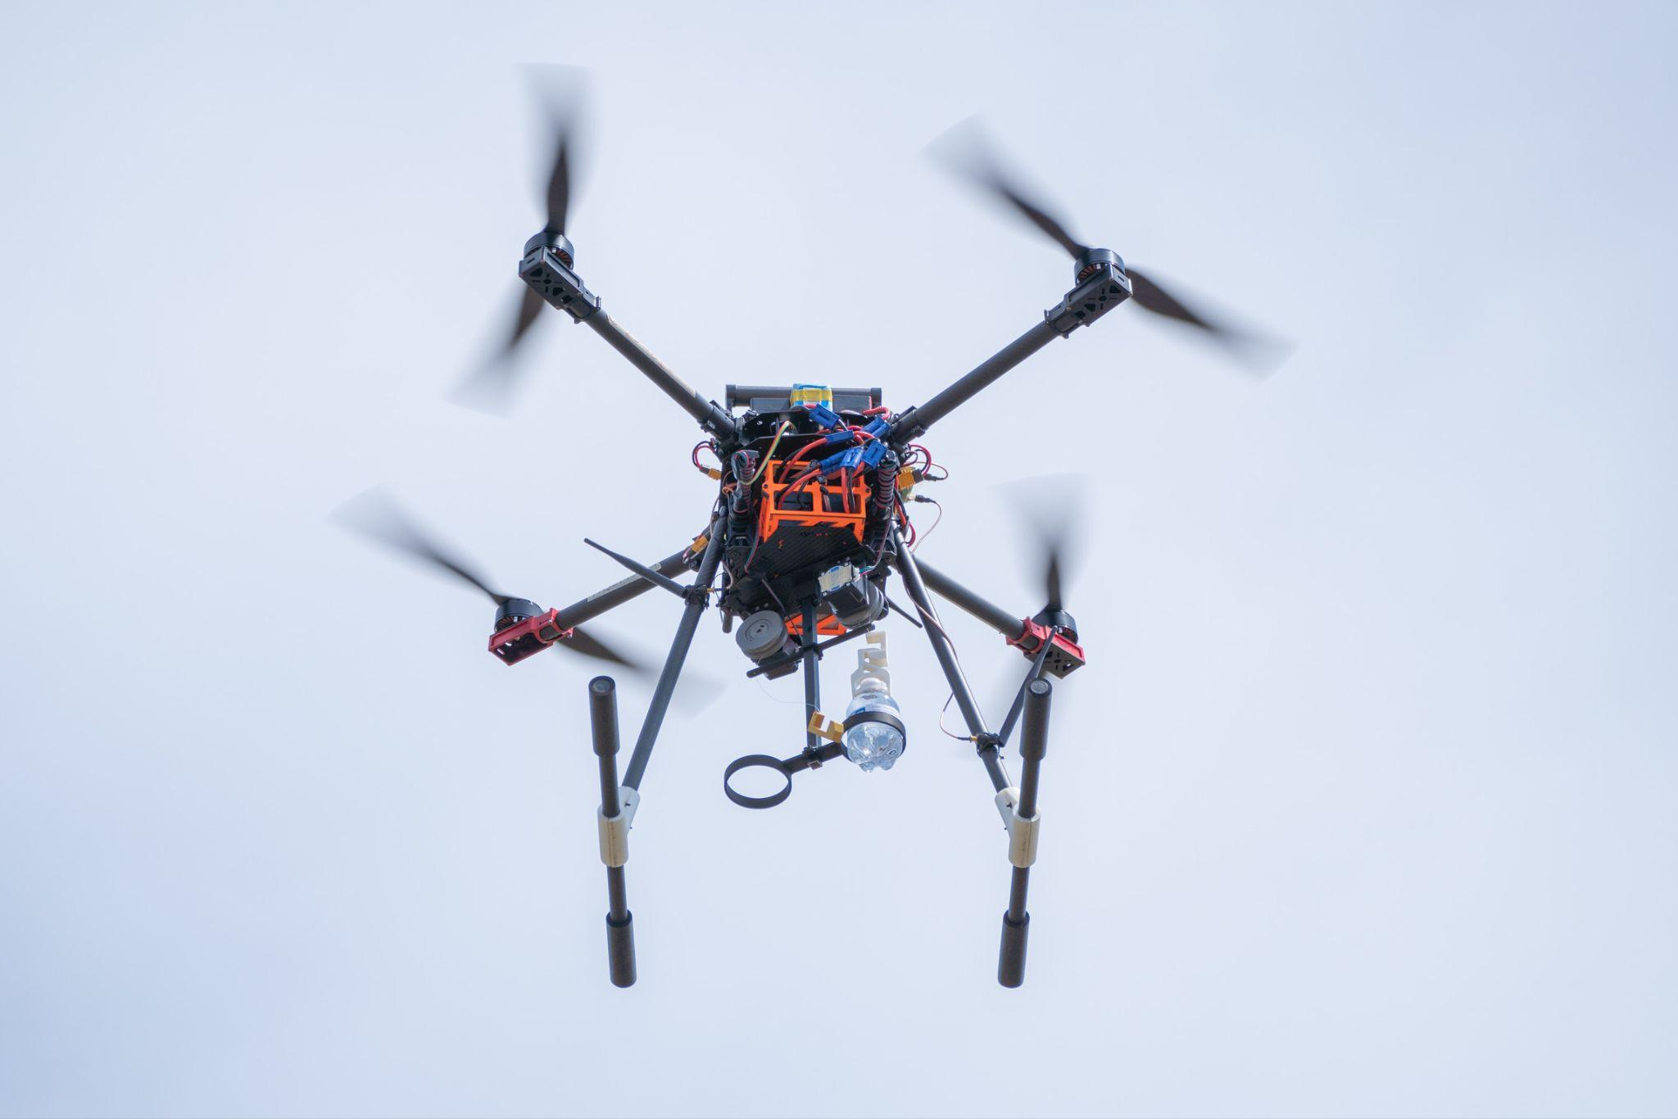
Fixed wing vs. Multirotor
Notes:
Haziq

Slide 9
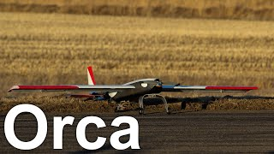
Orca
Notes:
Haziq

Slide 10
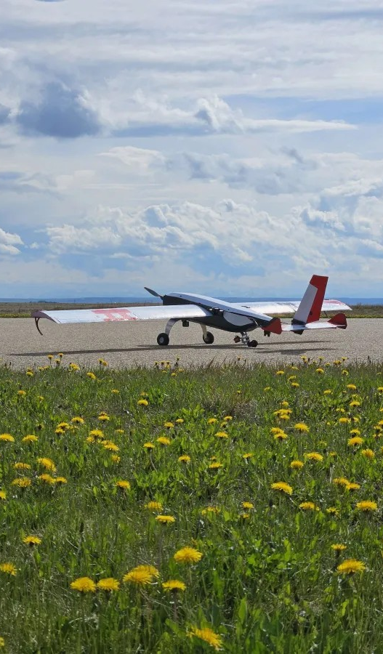
Schulich UAV
Design
Notes:
Taylor

Slide 11
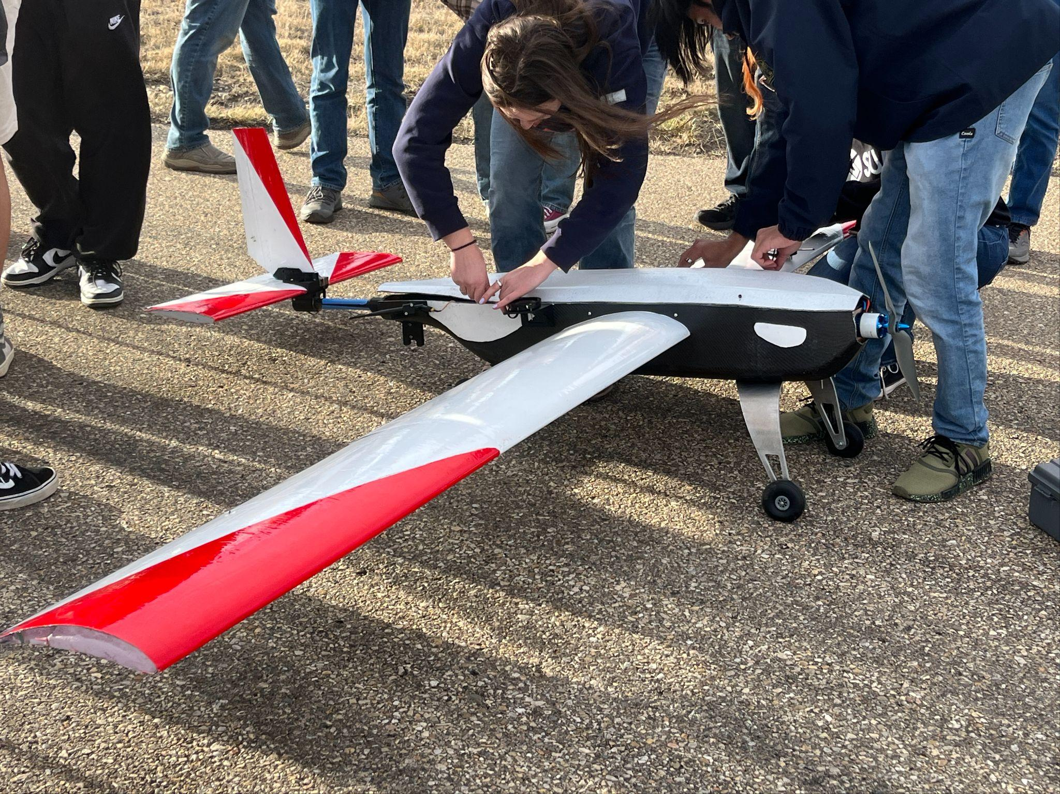
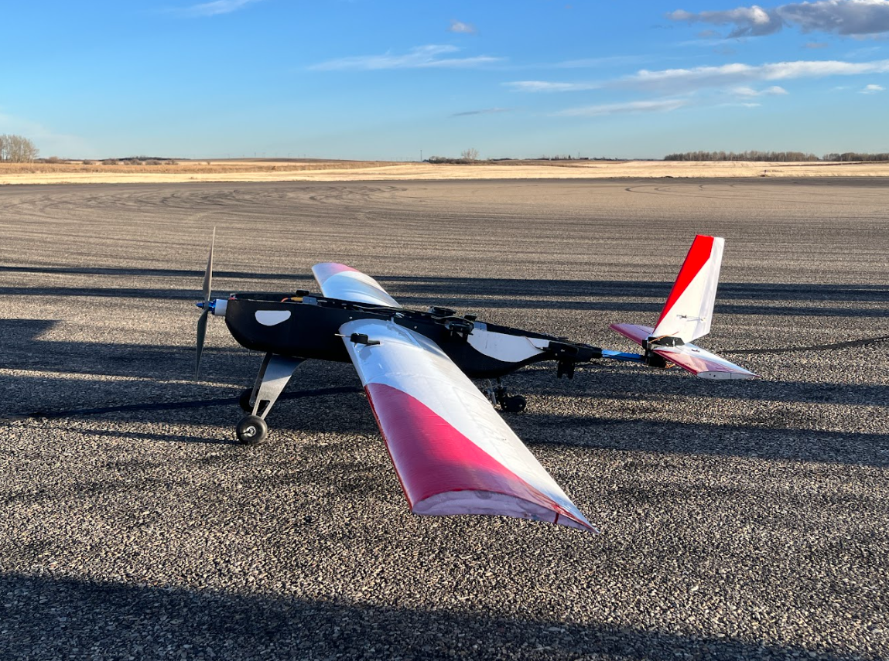
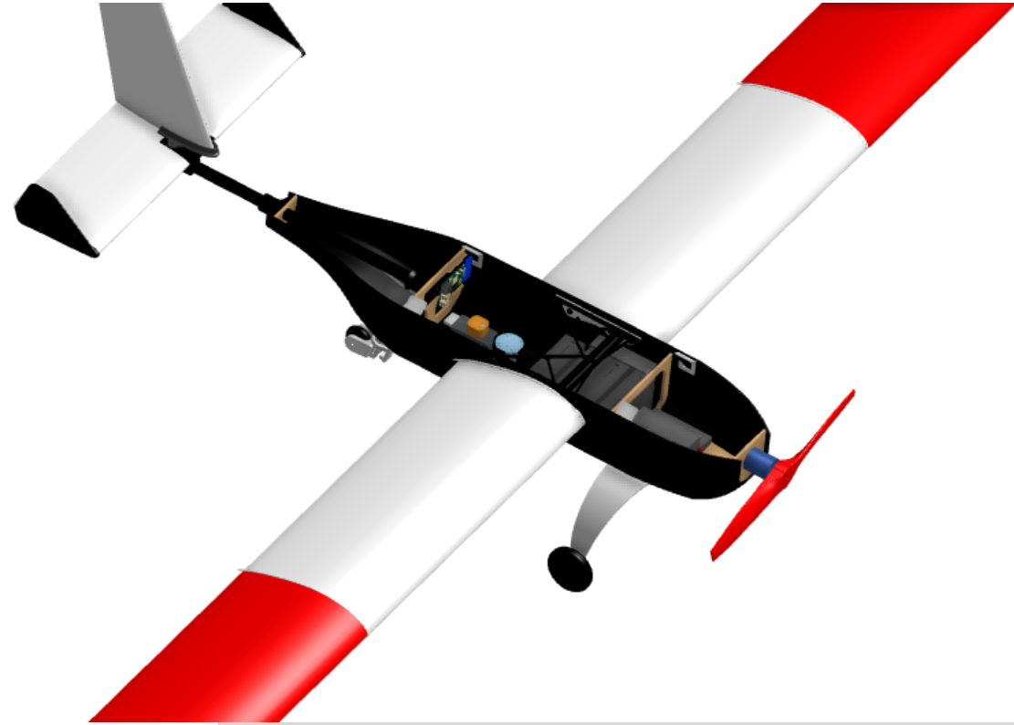
Mechanical
Overall Design Goals
Simplistic
Iterable
Easily-repairable
Ease of electronic access
Quick assembly time
Notes:
Taylor
Since we were taking a risk by designing a fixed wing aircraft in such a short development cycle, the mechanical team’s goals for Orca included making a simple yet robust design, which would be easily iterable for future improvements, and allow us to oprtimize on the fly, as well as easily repairable so that we could recover from inevitable crashes on test flights.
We also based our high level design goals on some of the flaws of our previous fixed-wing aircraft, Hammerhead. Some issues we experienced with our previous aircraft included lack of accessibility to electronics, resulting in slow assembly and set up time on fly days. We aimed to improve these issues with our design for Orca.

Slide 12
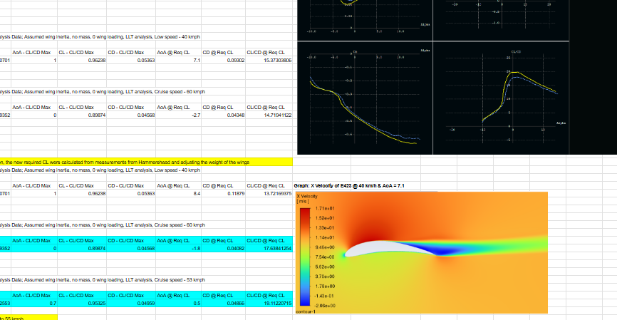
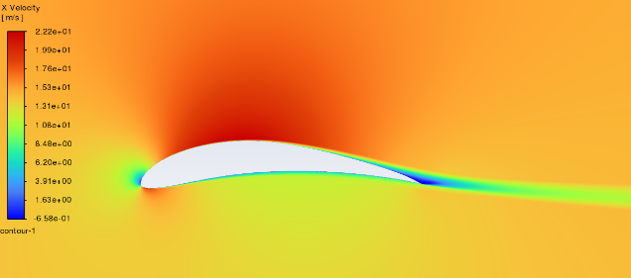
Aerodynamic Design
Design Constraints
Payload mass
Flight profile – imaging, payload drop, and cruise speed
Manufacturability, transport
Notes:
Taylor
The design of Orca began with an aerodynamic analysis, starting from a desired cruise speed for which we would be able to feasibly conduct payload drops and imaging at. Alongside this cruise speed, we also approximated the final mass of the aircraft based on a linear regression from historical aircraft, using the payload mass. This led us to determine other design elements such as airfoil and tail sizing, as well as our motor and propeller combo.
What we used to 'do our analysis' – we used XFLR5 for comparative analysis of airfoils with plots like lift coeff vs AoA, L/D vs AoA etc.
The picture in the slide is from ANSYS, and we used it to verify existence of flow separation at our cruise and low speeds
General design process:
Started from a linear regression to predict the mass of the aircraft, based on previous aircraft masses & the mass of the payload required
Chose a desirable cruise speed for imaging and payload deployment
Developed the wing and tail sizes based on these constraints
We also sized a motor and propeller for our aircraft in order to generate the thrust required
Other design constraints:
Manufacturability – we were limited in aerofoil airfoil shape that we would be able to hotwire cut out of foam – too narrow of a trailing edge would be too delicate, too much camber would be difficult to cut
Transport size – we would have to ensure that the wingspan would feasibly be able to fit on a plane for transport

Slide 13
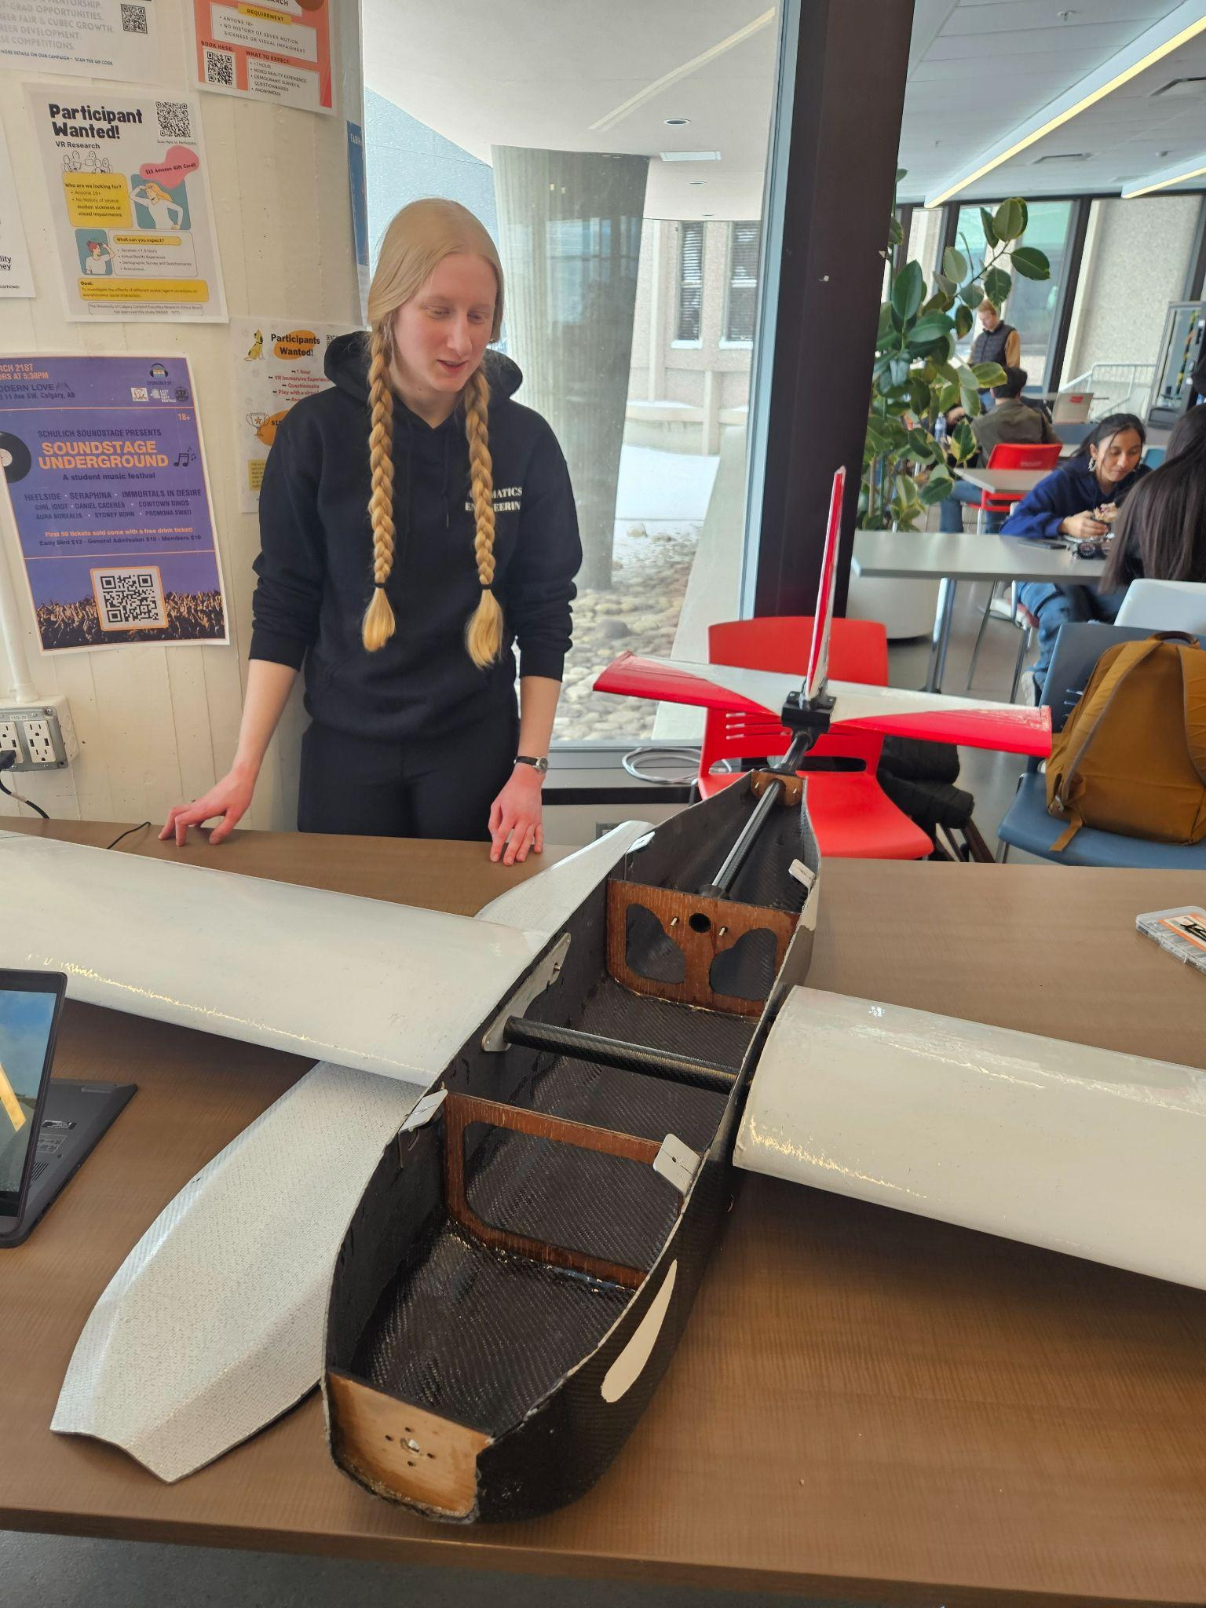
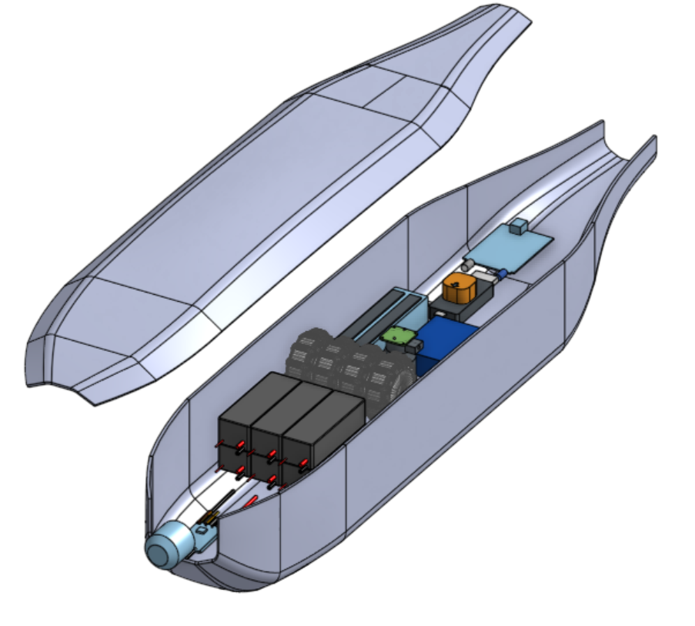
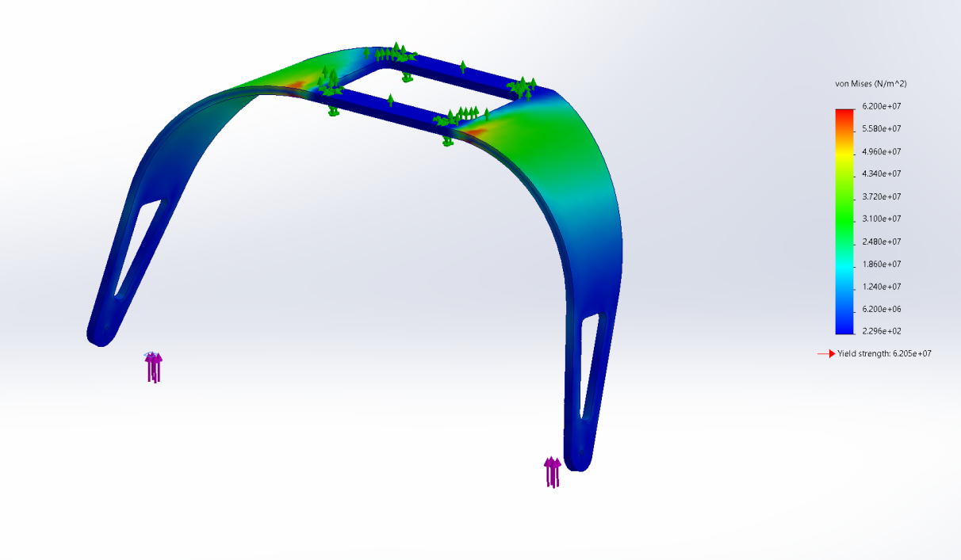
Manufacturing Design
Custom-designed & manufactured fuselage
Various custom 3D-printed parts
Emphasis on simplicity, ease of electronic access and setup
Notes:
Nadia (can keep this high level/don’t need to repeat manufac processes on both slides)
Alongside our aerodynamic design, we also designed and manufactured structural elements of our aircraft, such as our fuselage, internal structures, and landing gear. Emphasis on simplicity due to a short design cycle, and desire to easily repair in the case of crashes.
As well, In order to maximize accessibility, we opted to create a fuselage with a removable roof, allowing for easier setup for flights.
Our fuselage was completely custom designed to house all of our electronics and payload, and had internal wooden bulkheads made from laser cut plywood. We also made custom aluminum bulkheads and landing gear.
Various other components of our aircraft, such as mounts for our elevator and rudder, and other internal structures, were also custom-designed and 3D printed.
Our wings were manufactured by hotwire cutting foam into our desired airfoil shape, epoxying sections together along with aluminum bulkheads sandwiched between sections, and wrapping them in a layer of carbon fiber and epoxy resin.

Slide 14
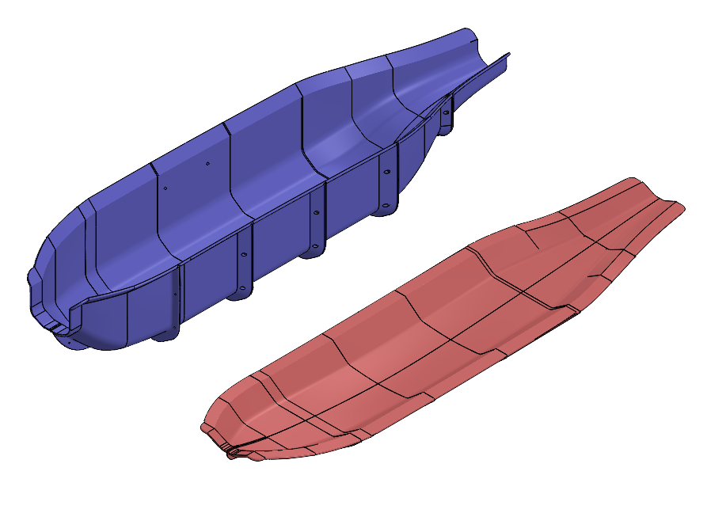
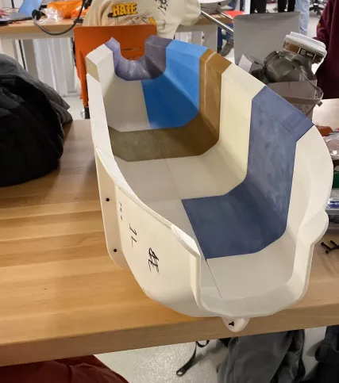
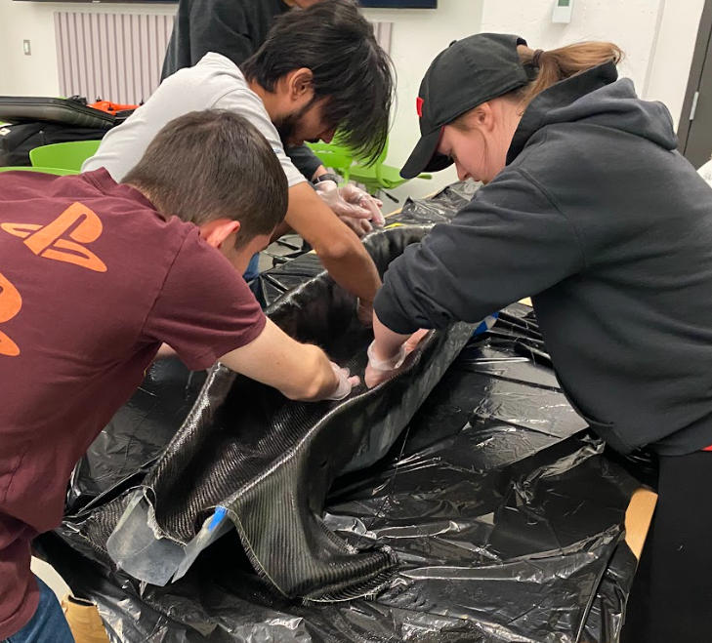
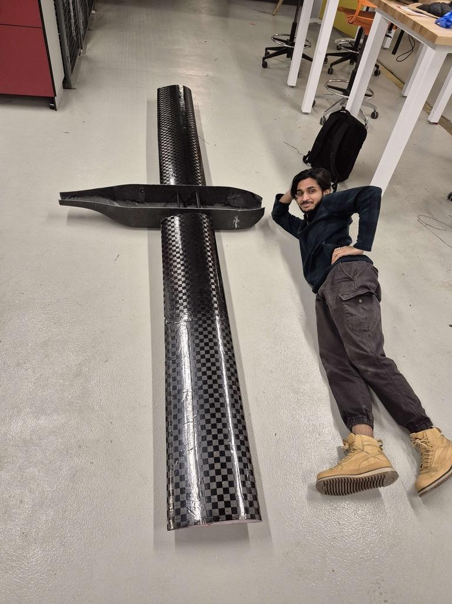
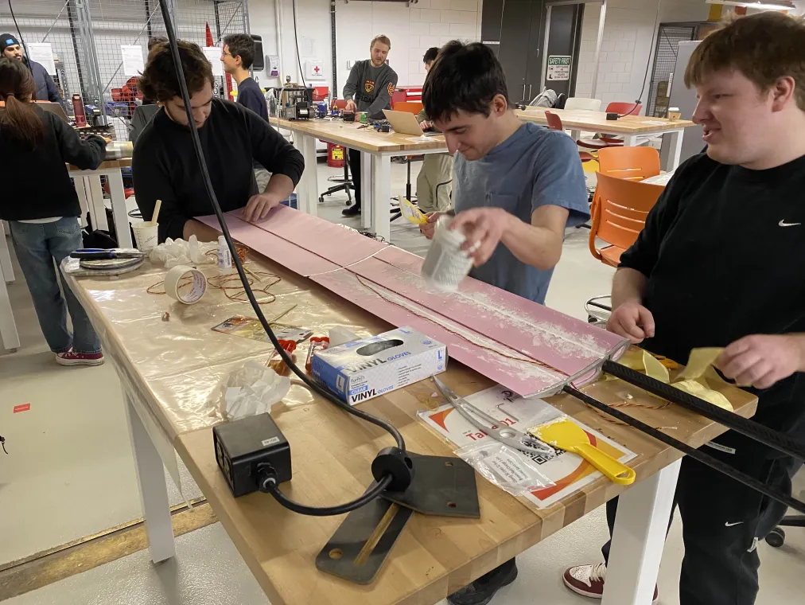
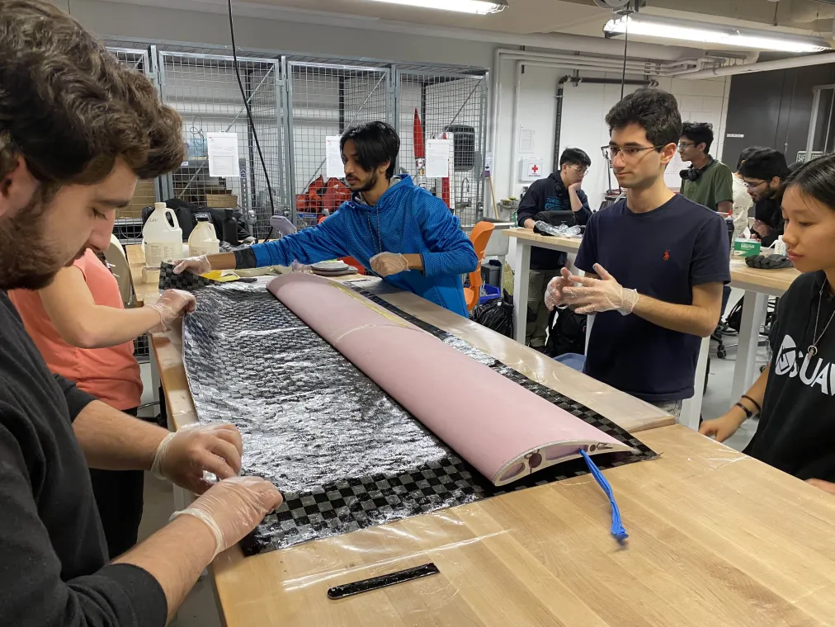
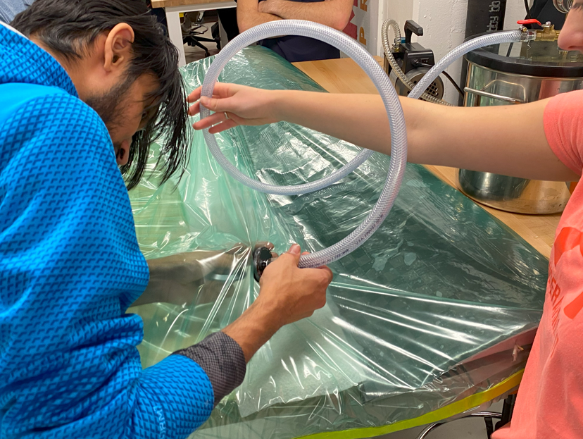
Manufacturing Design
Notes:
Nadia
Top images – fuselage manufacturing process. Started from 3D printed mold design, which was sized using computer-aided-design software, 3D printed, and then a carbon fiber layup was conducted inside this mold.
Bottom images – wing manufacturing process. Started from EPS foam cores which were hotwire cut into the desired airfoil shape, which were then covered in a layer of carbon fiber that was soaked in resin.

Slide 15
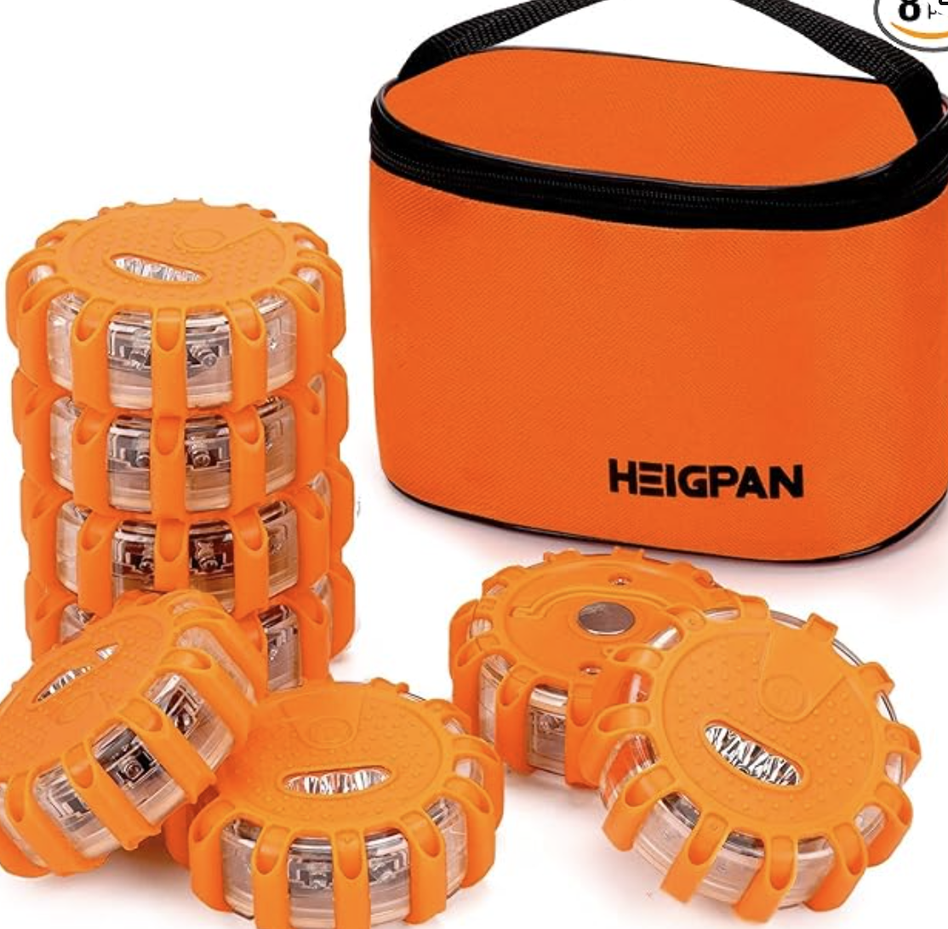
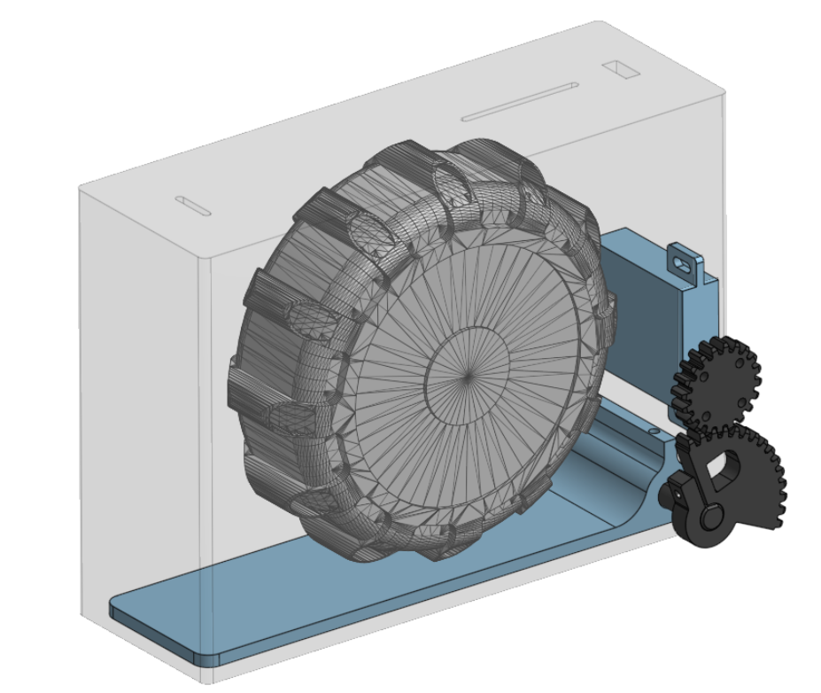
Payload
Based on fixed-wing aircraft, created a parachute payload deployment mechanism
Rapidly iterated payload bay designs
3D printed gear mechanism
Notes:
Based on our fixed wing aircraft, the most feasible payload deployment method would be some kind of parachute.
Other release mechanisms considered:
Gliders
Delayed parachute release, with some kind of electronic mechanism on it to delay the opening of the parachute
Based on competition rules, the payload could have some kind of electronic on it, it just could not be controlled manually
However, ultimately, for simplicity sake, we decided to use a traditional parachute tied to the payloads
The most complicated part of determining how we would drop our payloads, was designing the payload bays and release mechanisms. Ultimately, we created small 3D printed bays which would hold the beacons we were required to drop, which had a 3D printed gear and shaft mechanism that connected to the payload door and a servo motor. Our aircraft housed four payload bays within the fuselage for the max number of deployments.

Slide 16
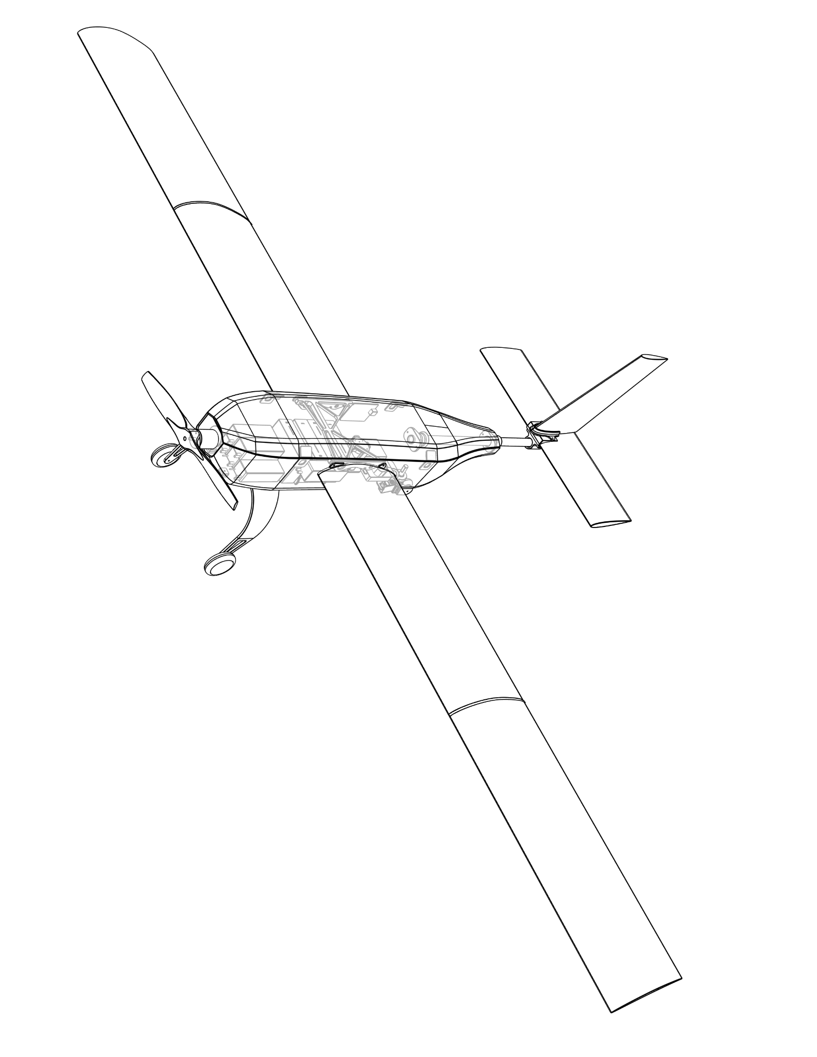
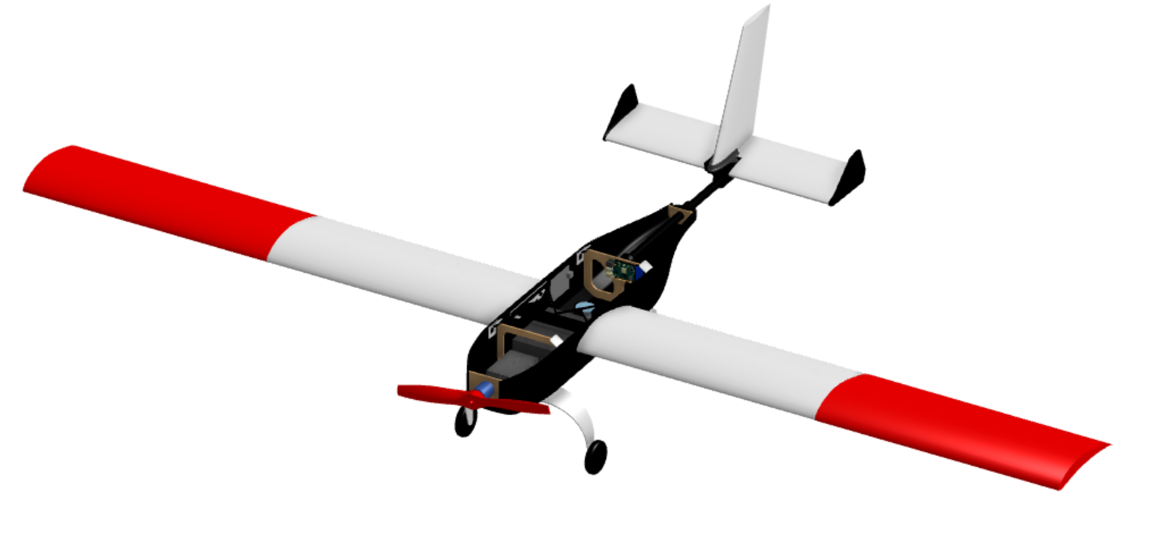
Final Aircraft
3D Printed Mounts
Carbon Wrapped Foam Core Wings
Custom Carbon Composite Fuselage
Payload Bays
Custom Aluminum Landing Gear
Laser Cut Wood Bulkheads

Slide 17
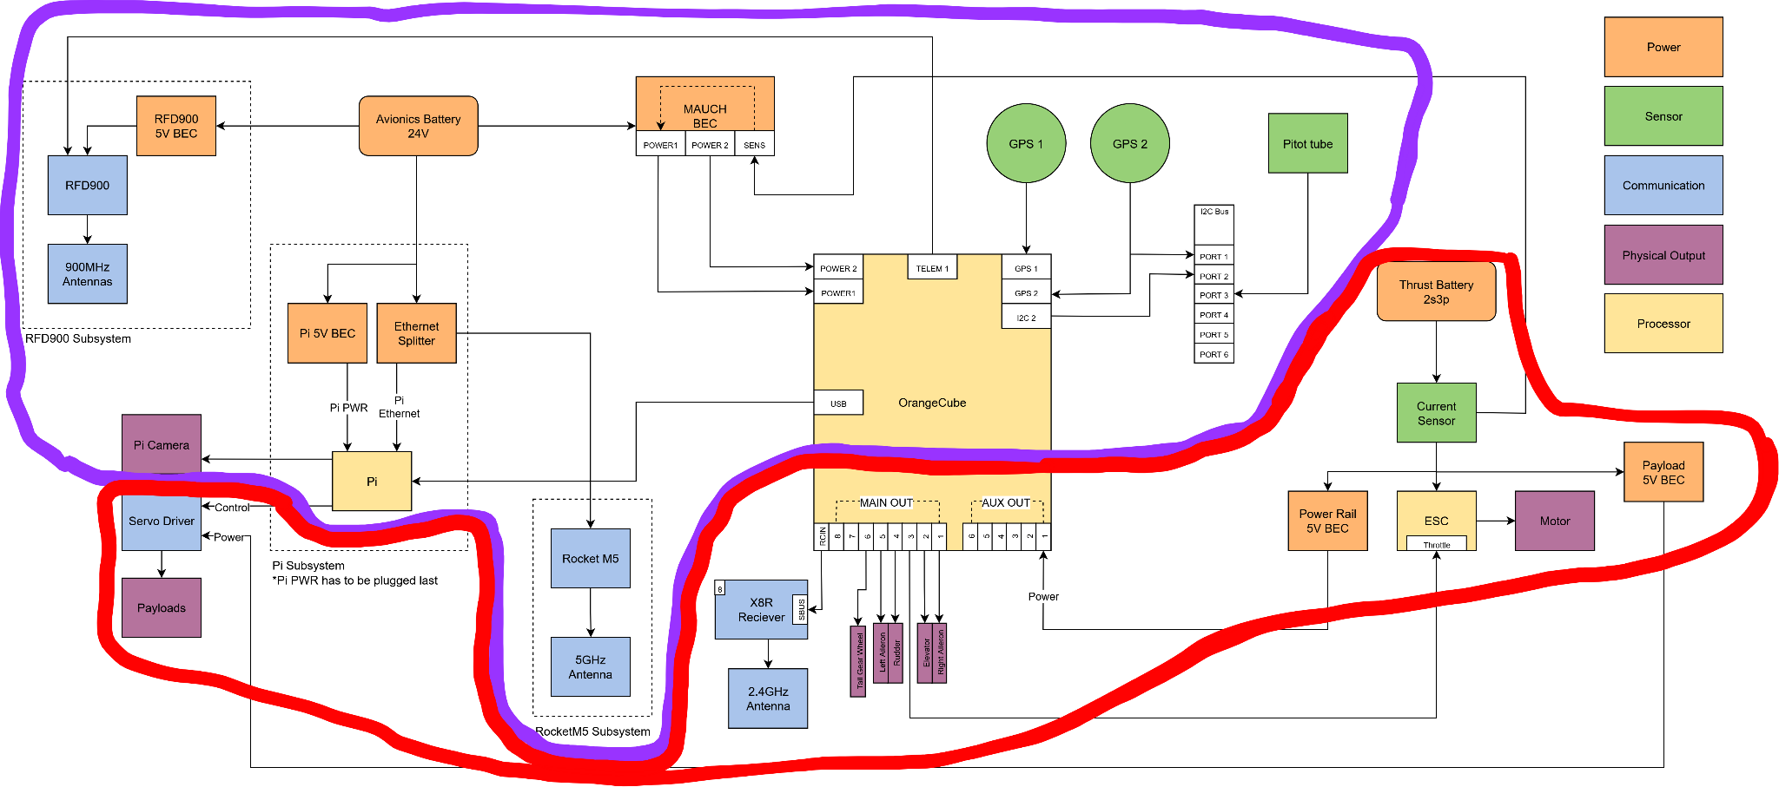
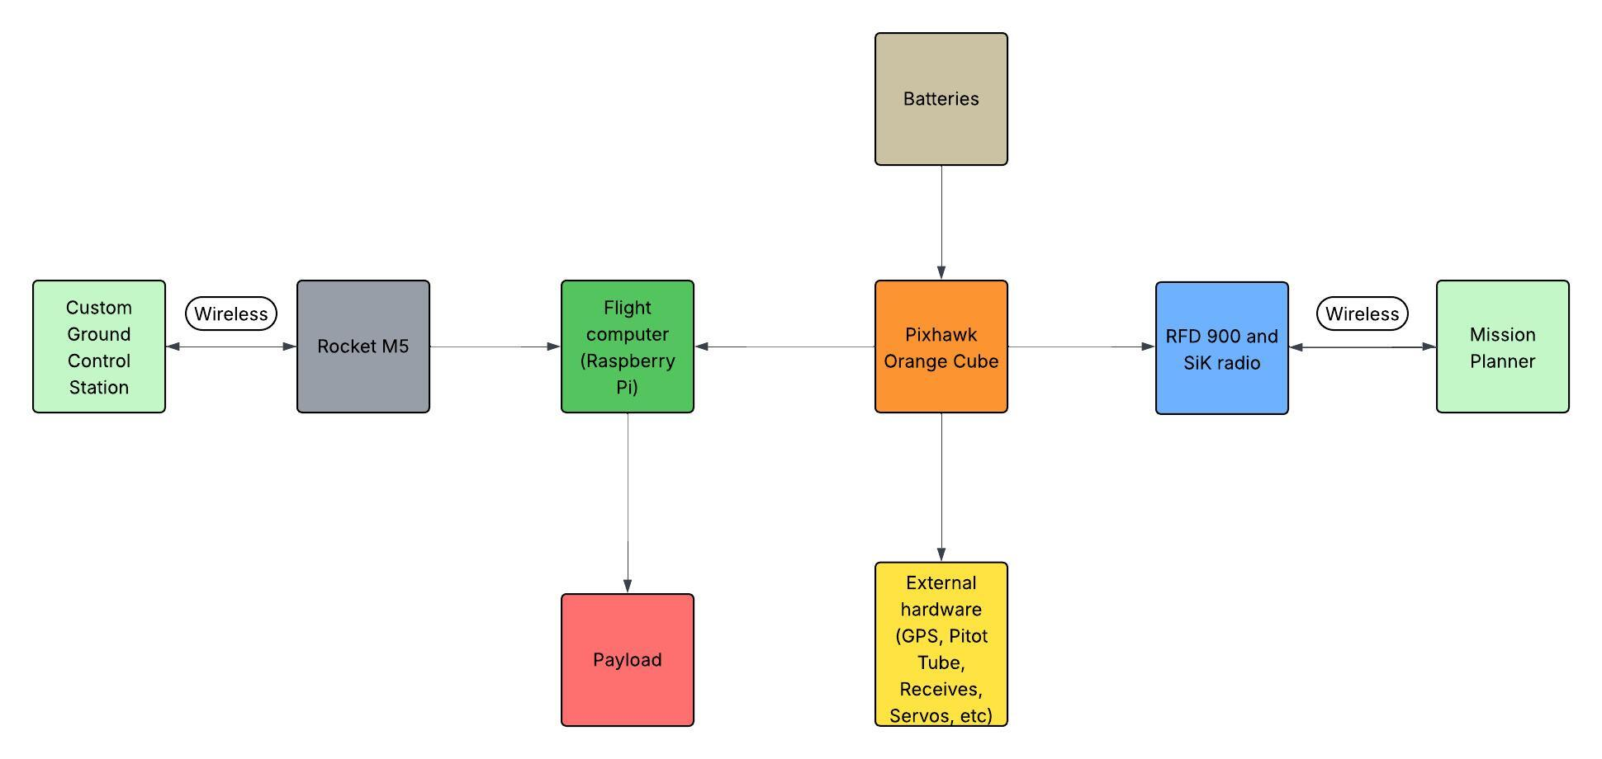
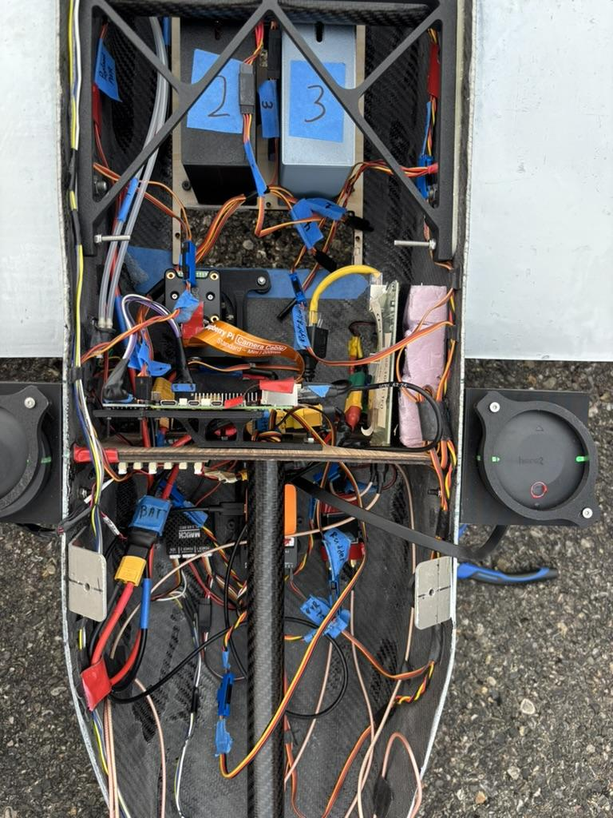
Avionics Ecosystem
ROBUSTNESS!
Notes:
Highlight the purposes of everything!
The avionics

Slide 18
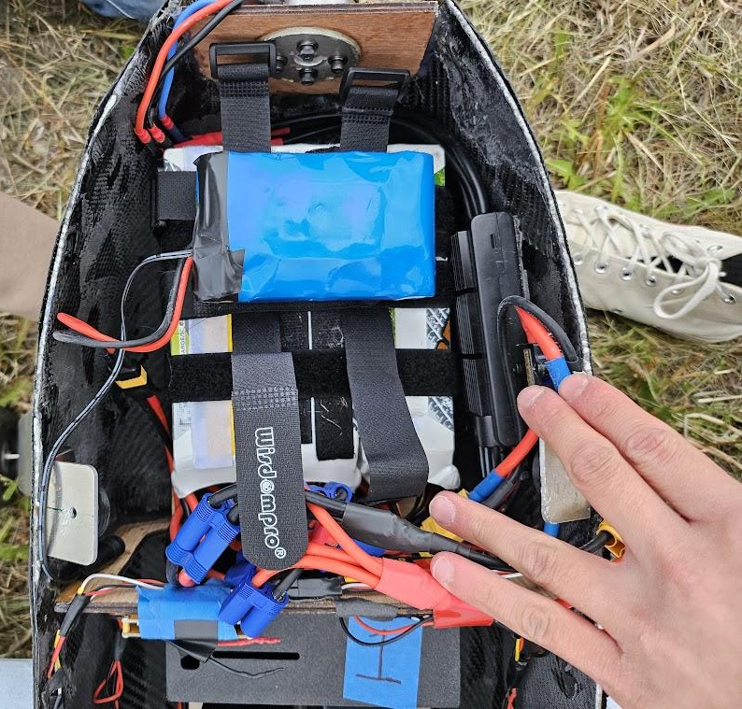
Power Management
Balanced flight range with weight constraints
Opted for two battery packs, one for the motor and one for the avionics
LiPo batteries, 6s4p, 22.2V, 32,000mAh
Discharge quick enough current to motor ~ 80A peak
Had infinite BECs to drop voltage to useable levels

Slide 19
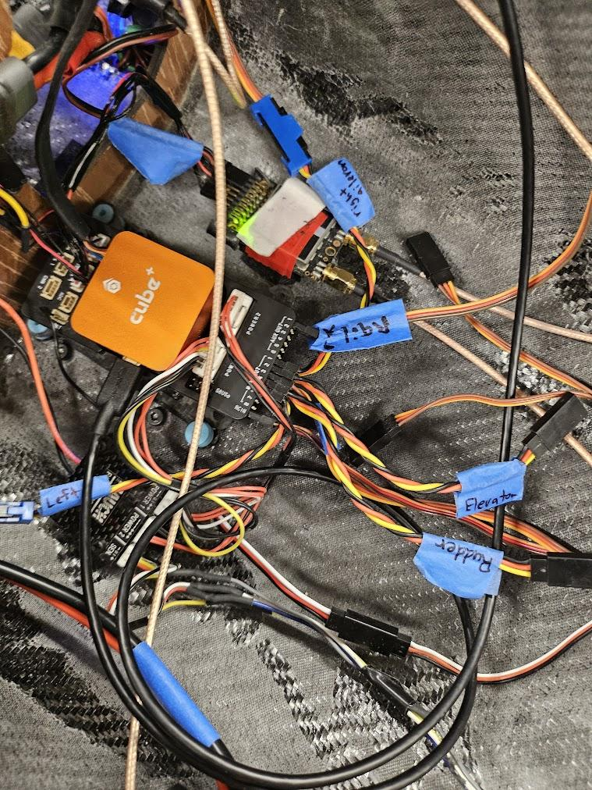
Autopilot and Sensors
Designed around Orange Cube Pixhawk flight controller
Dual GPS (blend) for redundancy
Pitot tube for measuring airspeed
Current sensor for sensing current
Communicates to Mission Planner with X8R 2.4 GHz receiver
Notes:
Performs all the calculations, outputs commands to motor and control surfaces

Slide 20
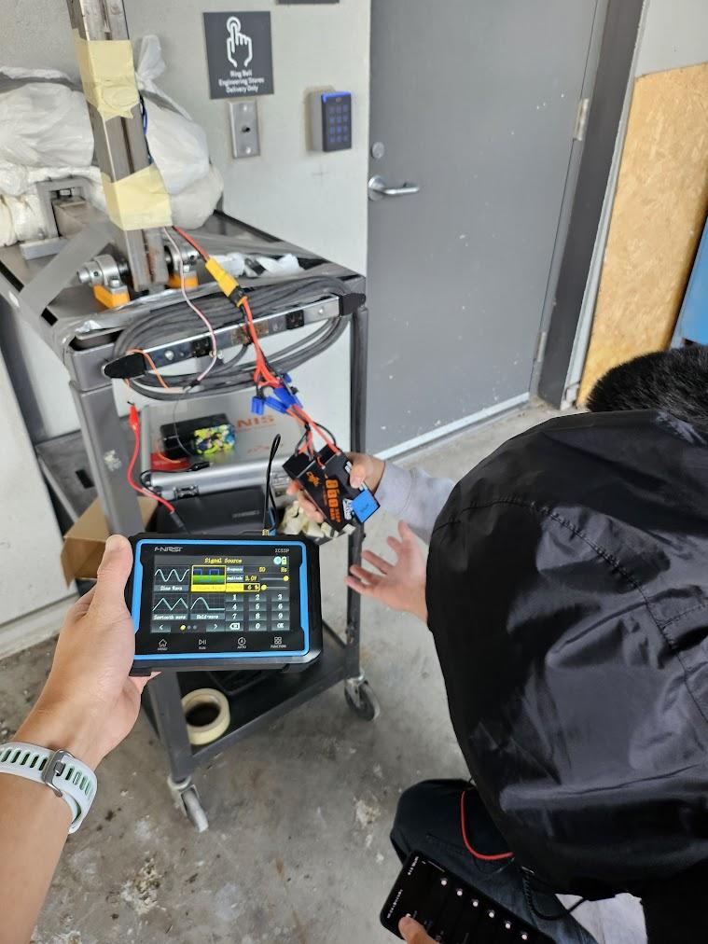
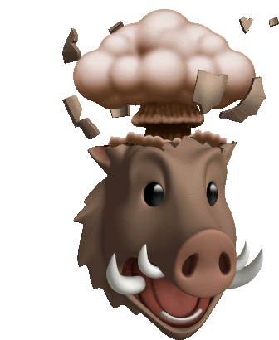
Motor + ESC
Throughout Orca’s development cycle, we’ve had different combinations of thrust systems
Started off with (insert motor) + (insert ESC)
For various reasons we’ve had to iterate 🥲

Slide 21
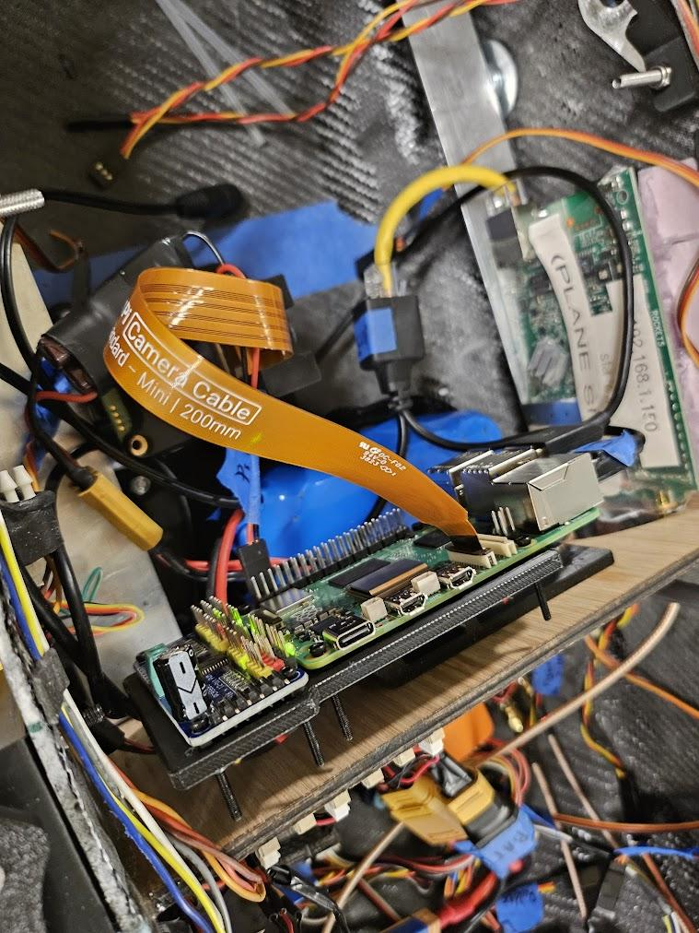
Raspberry Pi
Handles imagery and payload drops
Custom gcs communicates with Pi through Rocket M5
Sends mavlink commands to flight controller for custom waypoint drop missions
Lmah the goat ssh in

Slide 22

Software System Design
Notes:
Liam

Slide 23

Mission Planner
Positives
Free
Mission planning
Visual data and real time graphing
Built in SITL for testing
Extensive documentation
Easy access to ArduPilot parameters
Cons
Steep learning curve
Customization is complicated
Mission planning limitations
Windows only
Outdated interface
Notes:
Bryce

Slide 24

Custom Ground Control Station
Notes:
Liam
Our GCS uses a React frontend with a Flask + Python backend. We chose this stack because it’s common, front end looks good, reliable, and easy for our team which are students to work with.
The backend sends MAVLink commands directly to the aircraft, so we can see high-priority commands and reports like control flight modes, check system status, and adjust altitude easily.
We’ve also built custom features you which cannot be easily added or found in Mission Planner—like payload bay control, our own mapping algorithm, live payload status tracking, and a targeting algorithm for identifying mission objectives.

Slide 25





Flight Computer Software

Slide 26




Mapping
Notes:
Bit of context for next few slides, for the competition there was 2 areas which could score points, one by creating a map which is judged based on its quality and the second is the accuracy of autonomous payload drpos
To do this we utilized OpenDroneMap, or ODM, which is an open-source drone imagery to generate our 2d maps as you can see on the second photo and third photo
One thing to note, because there is strict time constraints to process our images results before the end of the mission, we ran into issues where ODM was to slow. So we had to customize several ODM parameters to speed up the processing.

Slide 27





Autonomous Payload Drops
Notes:
Autonomous payload drops depend on successfully integrating multiple systems together:
Aircraft must fly autonomously
Payload must work
custom gcs must operate correctly
Mapping system must identify the target
GCS must capable of uploading a mission
The system is only as strong as its weakest link and a successful autonomous drops require integration of all these components to be working perfectly .
Our payload drop algorithm uses a three-waypoint mission with various waypoint actions which is uploaded by our custom gcs:
example of custom mission ( use board as an example ) choose a 3 waypoint mission for a few reasons
Waypoint 1: a few actions occur when the waypoint is hit, Slows acts as a way to reduce speed and decrese the altitude to improve drop accuracy and orients it toward the target waypoint
Waypoint 2: Target object identified by our targeting algorithm; with this being an waypoint, it allows our flight computer to monitor the distance and based on a configured
value drop the payload some amount of meters away. Also when the waypoint is hit a few actions occur such as speeding up the plane so it can loiter safley and increase its altitude
Waypoint 3: Allows plane to speed up to reach a safe speed and loiters waiting further commands

Slide 28

Schulich UAV
Challenges
Notes:
Alexey

Slide 29



Crash #1
Notes:
Taylor + Haziq
Causes of failure: systems engineering problem
Prop was upsized prior to the flight, and ended up being too large for the motor
Motor was pulling too much current for the ESC, resulting in the ESC overheating and stopping
Additionally, there were some aerodynamic flaws with the aircraft, such as the rudder being too small – lead to us upsizing later on

Slide 30




Electronic Speed Controller (ESC)

Slide 31



Crash #2
Notes:
Haziq

Slide 32


Landing Gear

Slide 33




Autonomous Flight
Notes:
Liam

Slide 34


Control Surface Jittering
Notes:
Liam

Slide 35




Custom GCS Range Issues
Notes:
Bryce

Slide 36



Orca Before Competition
2 major crashes
15+ successful flights
3 successful payload drops
Successfully mapped 30+ acres of land
Over 100km flown autonomously
Over 4 hours of flight time
Notes:
Nadia

Slide 37

So, how did competition go?

Slide 38






Questions? Thank you!

Slide 39


Questions? Thank you!
Design Deliverables: 1st
Team Website: 2nd
Design Report: 2nd
Mission Demonstration: 34th

